Slide 1
The Microenvironment of muscle stem cells
Pr Fabrice Chrétien
Experimental Neuropathology
Institut Pasteur
Paris

Slide 2
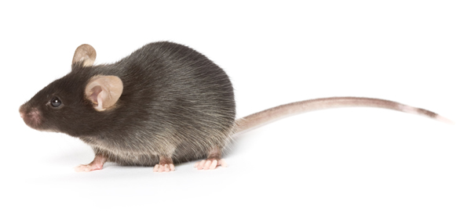
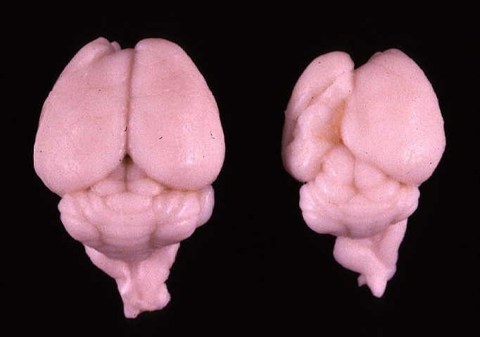
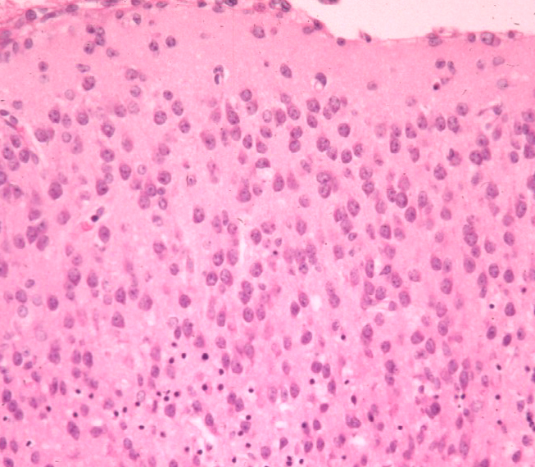
RESEARCH IN HISTOPATHOLOGY
HUMAN DISEASE
Understanding of the pathogenesis
HUMAN DISEASE
Unknown pathogenesis
FINE CHARACTERISATION OF THE MODEL
Clinic
Imaging
Mol. Biology
ANIMAL MODEL
COMPARATIVE PATHOLOGY
Macroscopic observation
Histopathologic analysis
Confrontation with lesions in human samples and extrapolation for a better understanding of the pathogenesis
RELEVANCE
HYPOTHESES
Noah’s Archive

Slide 3
Integrative analysis of cell-cell interactions
in normal tissues and after an injury
Resident cells
Blood vessel
Stem cell
Connective tissue
Notes:
A tissue is composed of resident differentated cells, stem cells located in a niche more or less diffined and blood vessels always separated to other cells by a barrier some time more imperameable such as in thebrain. The stromal part of the tissue should also be considered

Slide 4
Integrative analysis of cell-cell interactions
in normal tissues and after an injury
NORMAL TISSUE - HOMEOSTASIS
Barrier structure
Stem cell niche organisation
Notes:
This very precisely defined organisation is responsible for tissue homeostasis

Slide 5
Integrative analysis of cell-cell interactions
in normal tissues and after an injury
INJURY (infection, inflammation, toxic, …)
Notes:
After an injury tissue is destroyed more or less severely and vascular barrier is compromised
Injured tissue give rised to cell dr-erbis and the establishement of an inflammatory response that is the substratum of the tissue regeneration.

Slide 6
Integrative analysis of cell-cell interactions
in normal tissues and after an injury
NORMAL TISSUE - HOMEOSTASIS
Barrier structure
Stem cell niche organisation
ACUTE POST-INJURY PHASE
Protective barrier crossing/alteration
Early tissue response:
Cell damage
Inflammation
Role of blood vessels/perfusion

Slide 7
Integrative analysis of cell-cell interactions
in normal tissues and after an injury
NORMAL TISSUE - HOMEOSTASIS
Barrier structure
Stem cell niche organisation
ACUTE POST-INJURY PHASE
Protective barrier crossing/alteration
Early tissue response:
Cell damage
Inflammation
Role of blood vessels/perfusion
CHRONIC POST-INJURY PHASE
Chronic inflammation
Tissue regeneration
Functional recovery
Fibrosis/Scar
Notes:
During regeneration two scenarios oculd be observed one id-s the ad integrum regeneration of the tissue with reconstitution of stem cell niches and restitution of differentiated cells and the other one is the formation of a scar that is usually fibrotic such as what observe in the muscle

Slide 8
Integrative analysis of cell-cell interactions
in normal tissues and after an injury
NORMAL TISSUE - HOMEOSTASIS
Barrier structure
Stem cell niche organisation
ACUTE POST-INJURY PHASE
Protective barrier crossing/alteration
Early tissue response:
Cell damage
Inflammation
Role of blood vessels/perfusion
CHRONIC POST-INJURY PHASE
Chronic inflammation
Tissue regeneration
Functional recovery
Fibrosis/Scar

Slide 9
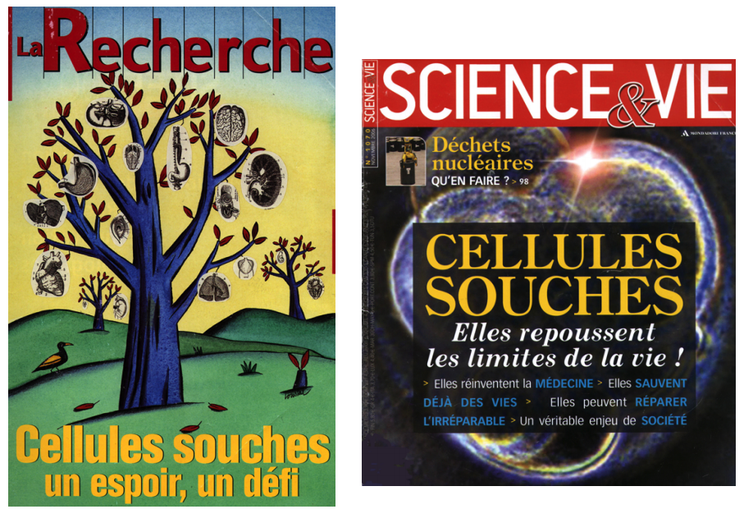

Slide 10
Stem cells in their niche
Transient signal
Dominant signal
Adapted from Xie and Li, 2007

Slide 11
Bone marrow niche

Slide 12
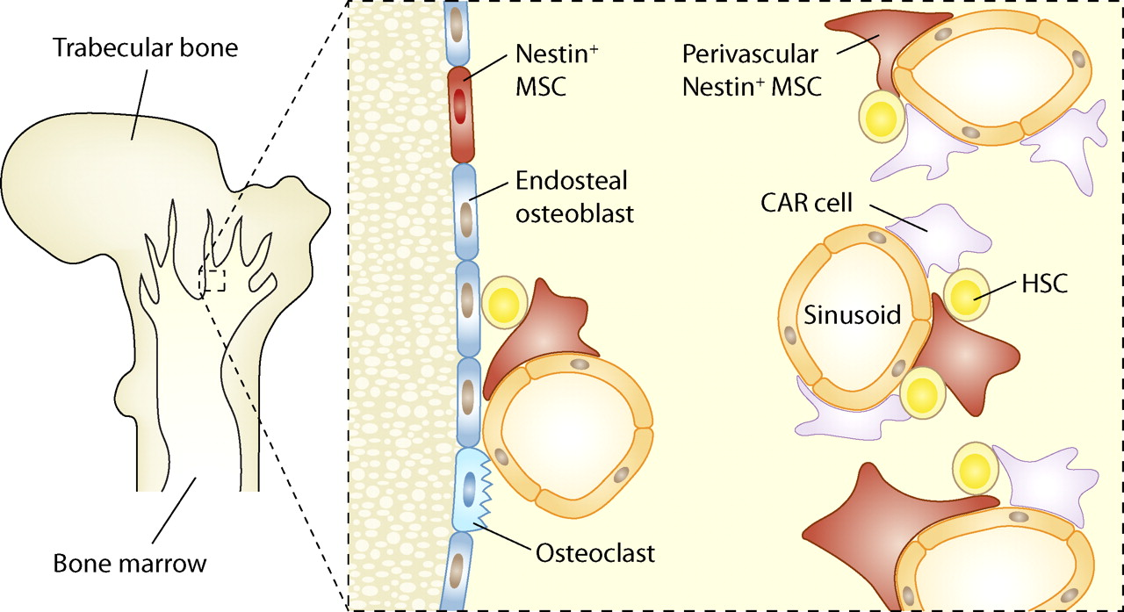
Bone marrow niche

Slide 13
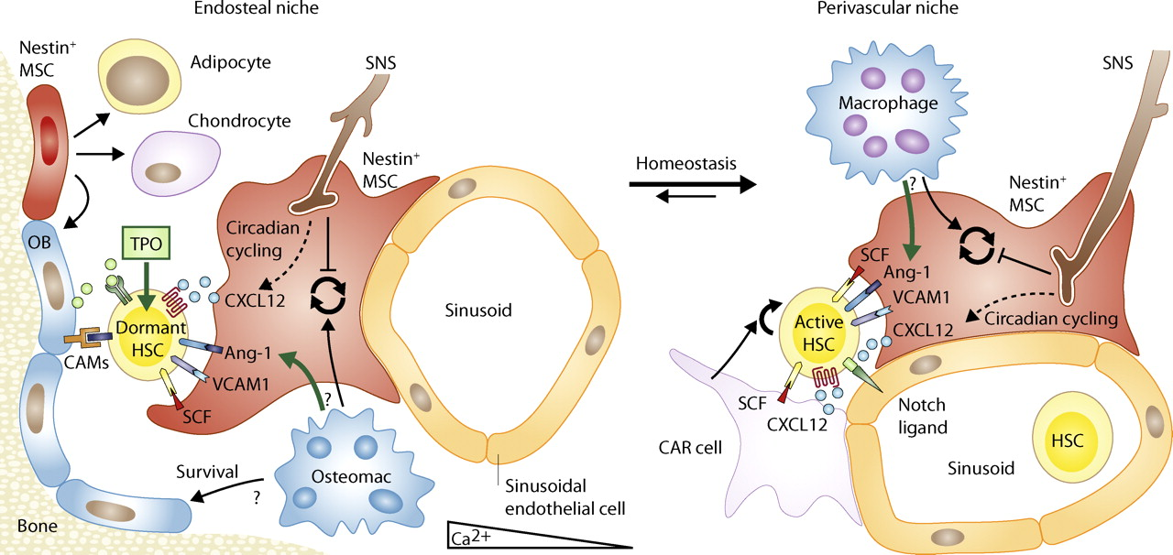
Bone marrow niche

Slide 14
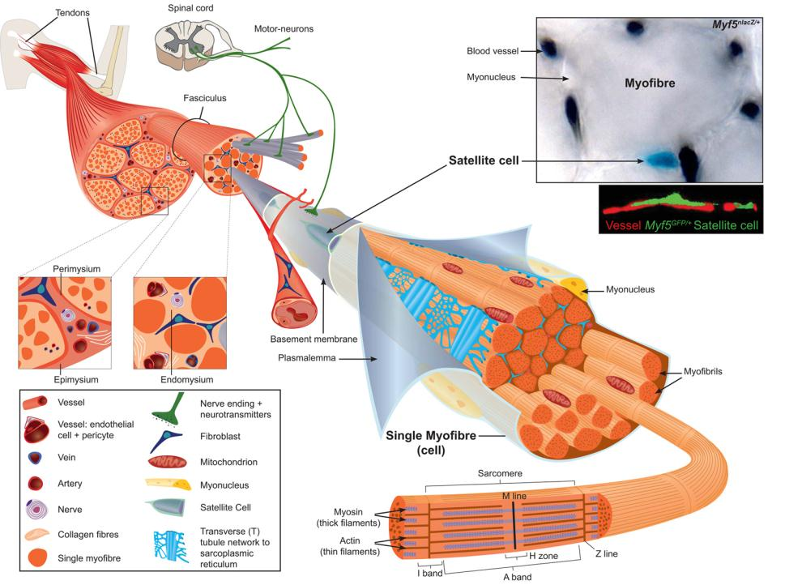
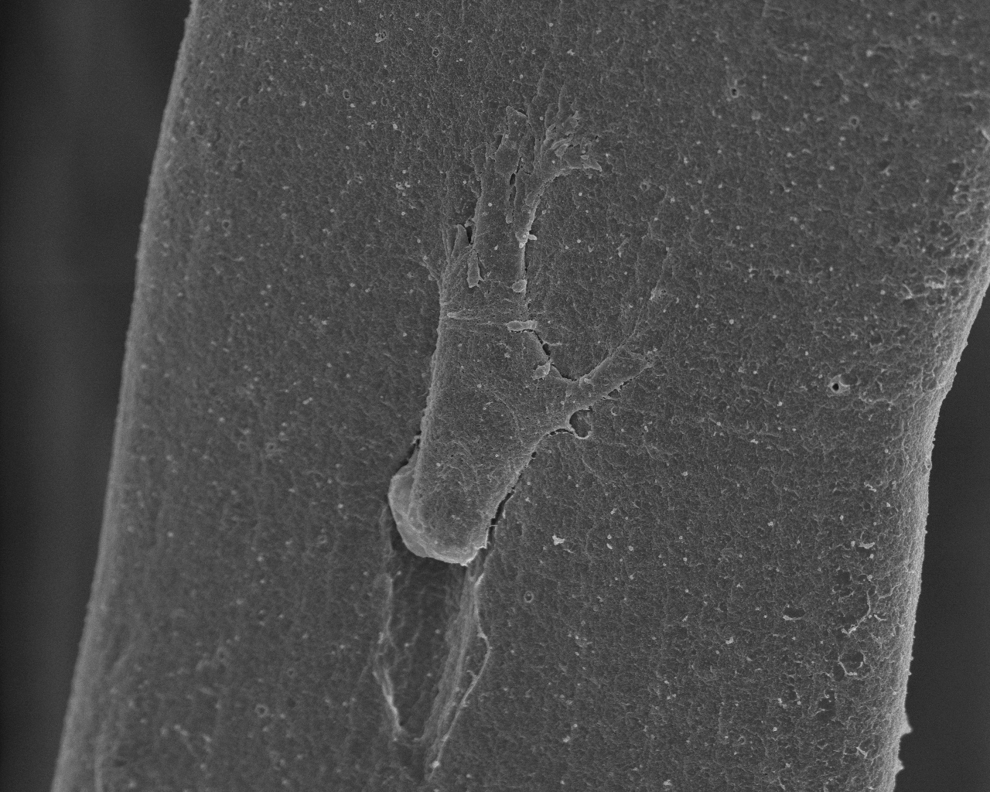
An example: Skeletal muscle tissue
Tajbakhsh, 2009, J. Intern. Med
Notes:
The skeletal muscle is paradigmatic for studying tissu organisation as well as regeneration because of abundant stem cells hosted in a clearly defined niche and remarkable capacities to regenerate.
I would like to remind you that, as you all know, muscle is a complex tissue, highly specialized, not only composed of contractile muscle fiber but also of connective tissue, nervous tissue, vessels and adult stem cells.

Slide 15
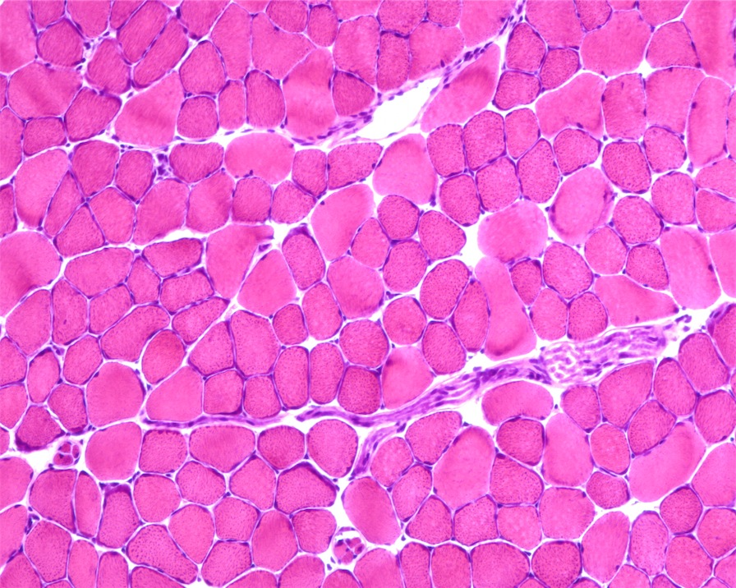
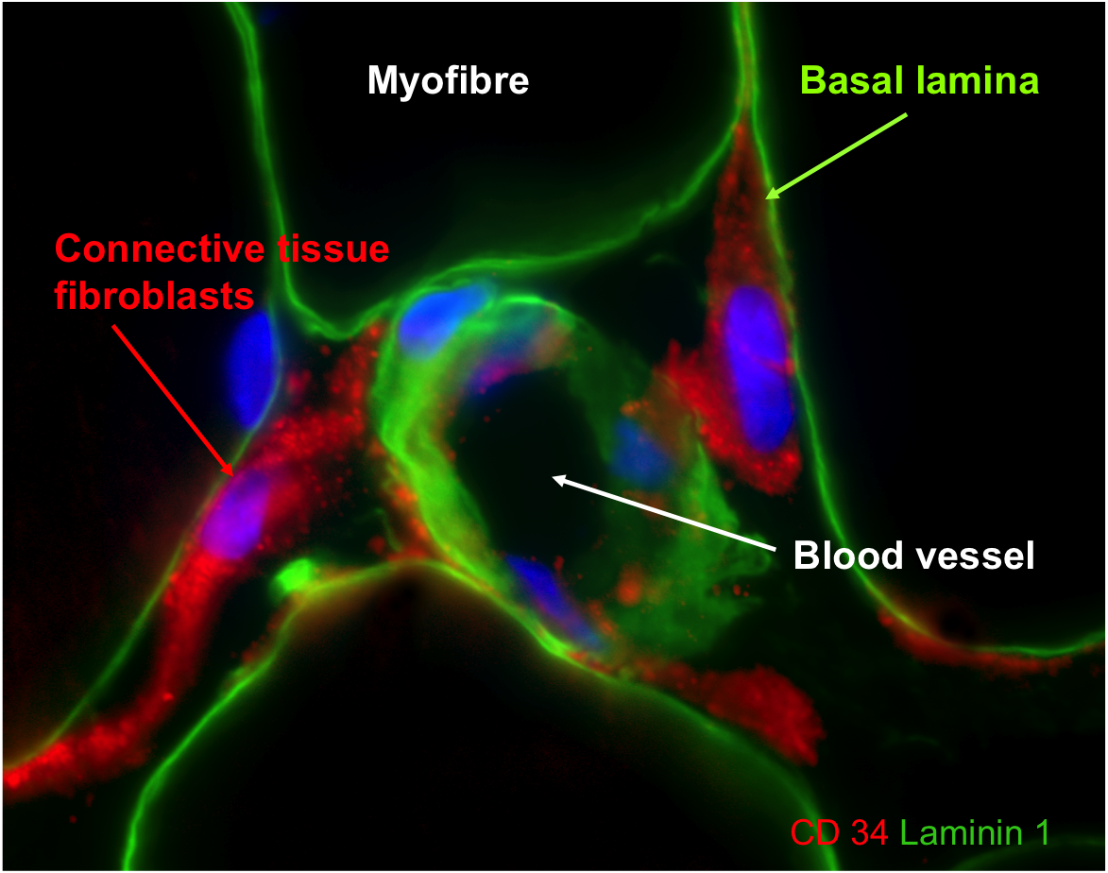
Tissular complexity
Structures :
Fibres musculaires
Tissu conjonctif
Vaisseaux sanguins
Motoneurones
Types cellulaires :
Position sous basale
Cellules satellites
Cellules peu définies
Position extra basale
Cellules endothéliales
Fibroblastes
Cellules inflammatoires
Cellules nerveuses
Péricytes et mésoangioblastes
PICS
Cellules souches mésenchymateuses

Slide 16
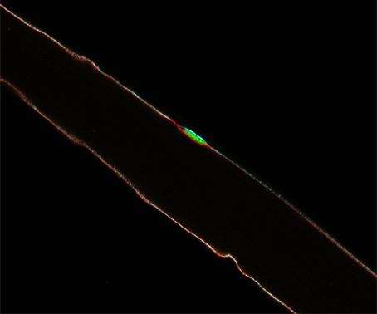
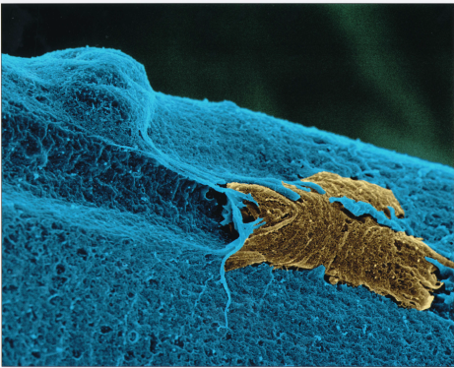
Satellite cell: major regenerative cell type in skeletal muscle
Tg:Pax7nGFP Sarcoglycan Laminin
Satellite cell
(Quiescent)
Satellite cell
Myofibre
In collaboration with S. Tajbakhsh
SEM
Pax7⁺
Myf5^{nlacZ}
Pax7⁺
MyoD⁺ Myf5⁺
MyoD⁺ Myf5⁺
Desmin⁺
MyHC⁺/ Myogenin
Quiescent
Satellite
cell
Activated
Satellite
cell
Myoblast
Fibre
Self-renewal
Notes:
This skeletal muscle regeneration is in part due to adult stem cells called satellite cells which should be considered as the major regenerative cell type in skeletal muscle.
The satellite cells, here in green from the TgPax7GFP mouse, are sparsely located on muscle fibers. They reside on the surface of the myofibers under the basal membrane. In a resting muscle, the cells are quiescents. Upon growth or injury, they get activated, they proliferate and these steps can be nicely recapitulated in the explant model of the isolated single myofiber. After few days, most of the cells differentiate as shown by the expression of the differentiating marker myogenin, and some cells re-enter quiescence and maintain the expression of progenitor marker like the transcription factor Pax7.

Slide 17
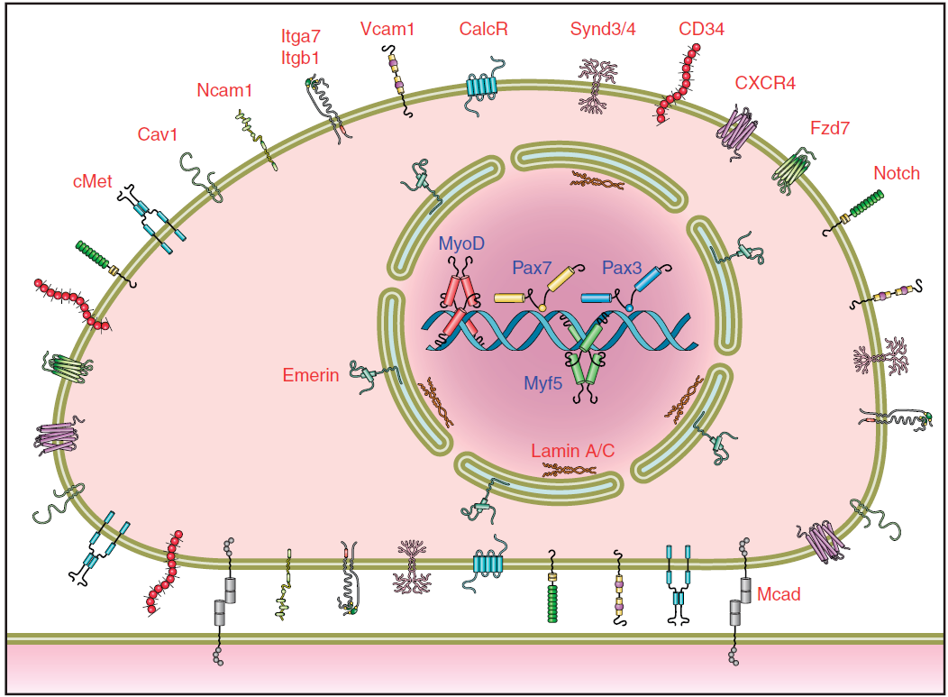
Satellite cells markers
Notes:
17
Due to heterogeneity in satellite cell populations, it is unlikely that all of these markers are expressed in a given satellite cell at a specific time. Nevertheless, this panel summarizes the cellular location of markers used to identify satellite cells.
Of these, Pax7 is the canonical biomarker for satellite cells as it is specifically expressed in all quiescent and proliferating satellite cells across multiple species, including human, monkey, mouse, pig, chick, salamander, frog, and zebrafish.
17

Slide 18
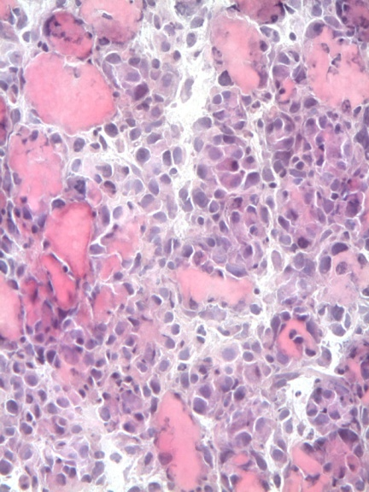
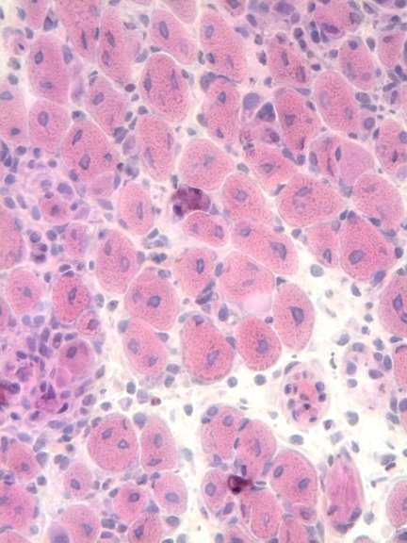
Regeneration of skeletal muscle
Regeneration ad integrum
Different injury models (myotoxin, freezing, chemical, crush)
Control 3 days 7 days 28 days
Notexin injection into Tibialis anterior muscle – Hematein Eosin
Notes:
The skeletal muscle tissue has the outsanding capacity to regenerate ad integrum.
Numerous injury models such as myotoxins like snake venom, freezing, etc can provoke degeneration and regneration of muscle. In the unit, I collaborate with another PhD student, in a work that compare all these injury models.
All these models have as a starting point an initial necrosis and as a final result a complete restitution of the tissue but there is a black box between these two points and understanding precisely the role of each cell type in muscle regeneration is critical.

Slide 19
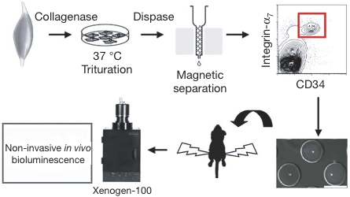
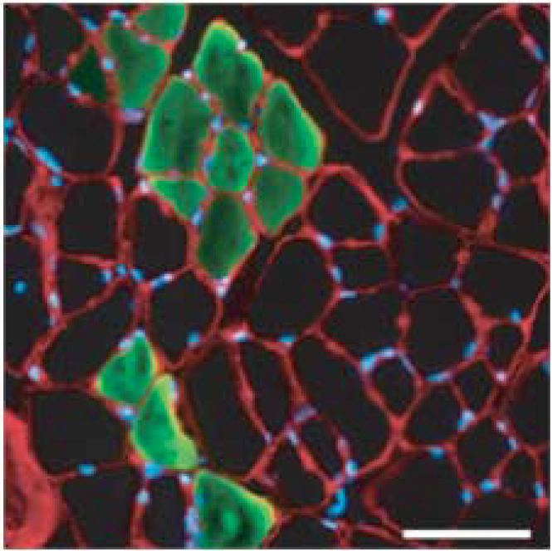
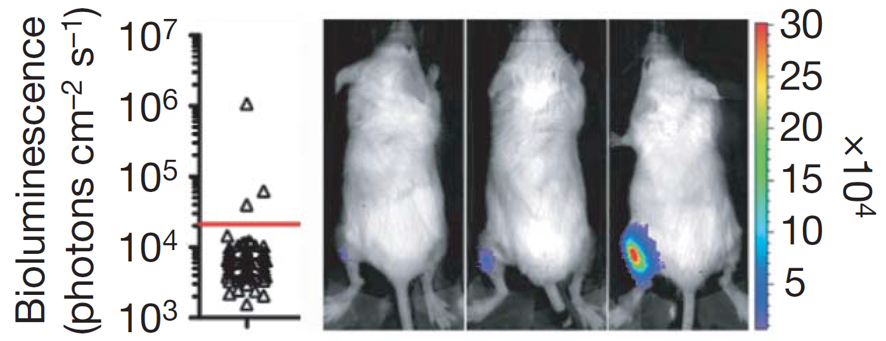
Proliferation and self renewal of muscular stem cells
One muscular stem cell can self renewal and differenciate after grafting
(Sacco, 2008)

Slide 20
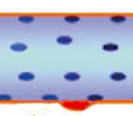
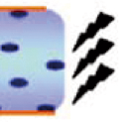
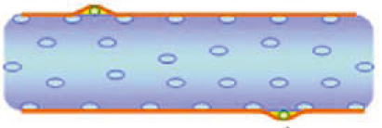
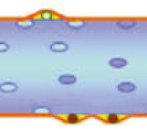
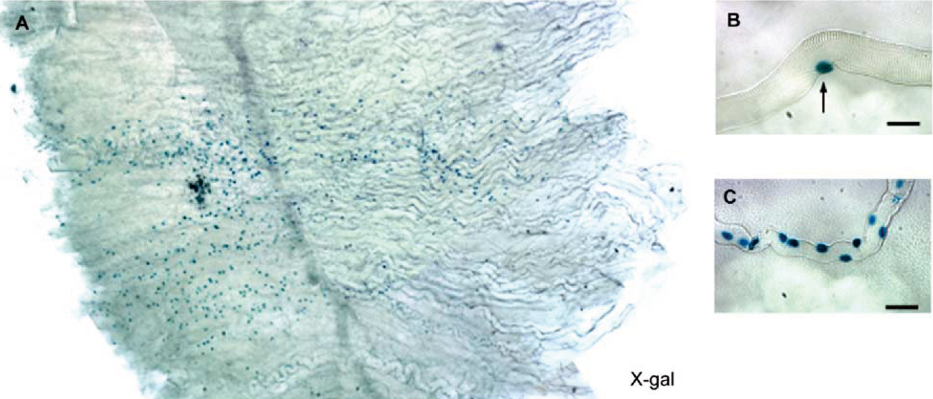
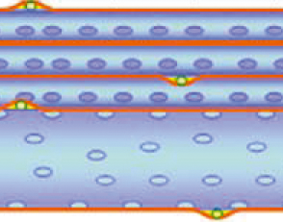
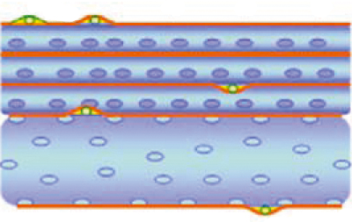
Muscular regeneration and self renewal
Irradiation
Single fiber with associated satellite cells grafted
(22 cellules satellites Myf5^{nLacZ/+})
Activation of satellite cells
Amplification Diffusion
Importance of satellite cells niche
(Collins et al., 2005)

Slide 21
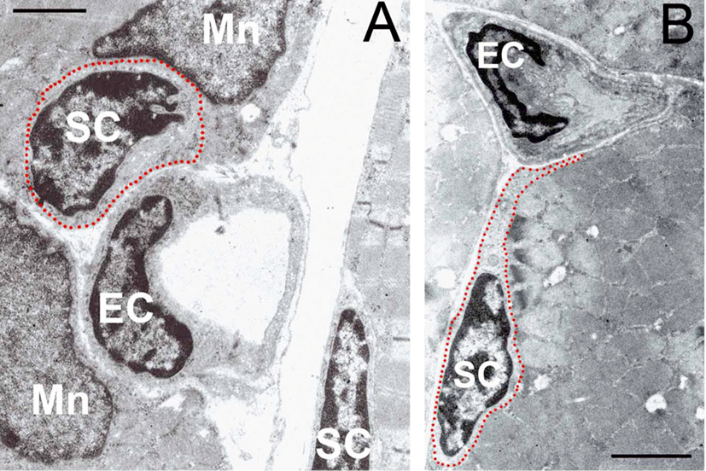
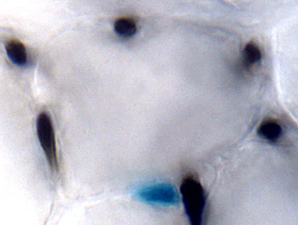
Satellite cells are associated with vessels
50
40
30
(Christov et al, 2007)
% fibers with sat cells within each fiber class
20
Blood vessel
10
0
0
1
2
3
4
5
6
7
8
Myofibre
Number of capillaries per fiber
Satellite cell
nucleus
Myf5^{nlacZ} satellite cell

Slide 22
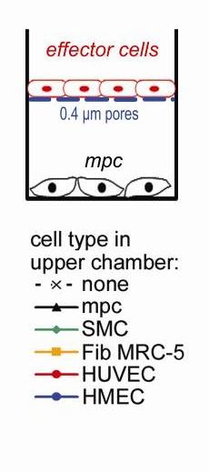
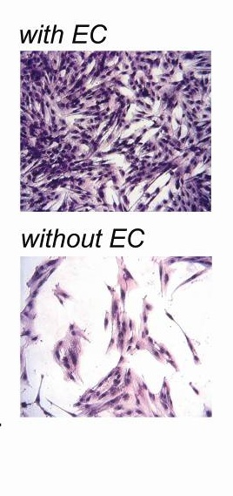
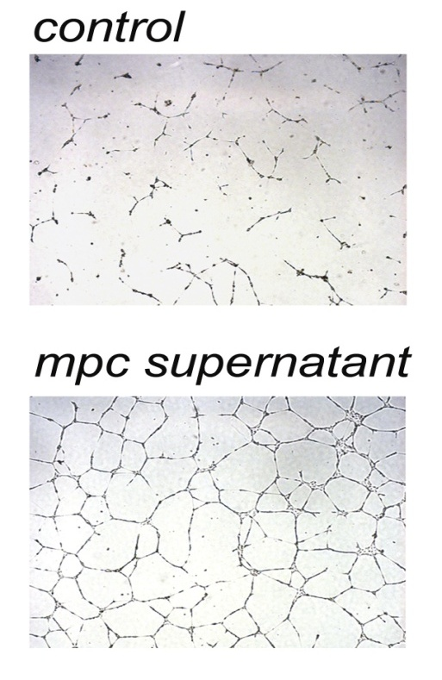
Satellite cells interplay with endothelial cells
ECs + MPC supernatant
MPCs + ECs supernatant
Notes:
Functionnaly we have also shown that SatC and Ecs cross-talk.
In vitro co-culture experiments demonstrate that SatC induce angiogenesis and a contrario that Ecs are able to induce proliferation of SatC and reduce apoptosis
One of the factors involved in survival has been identified to be VEGF.

Slide 23
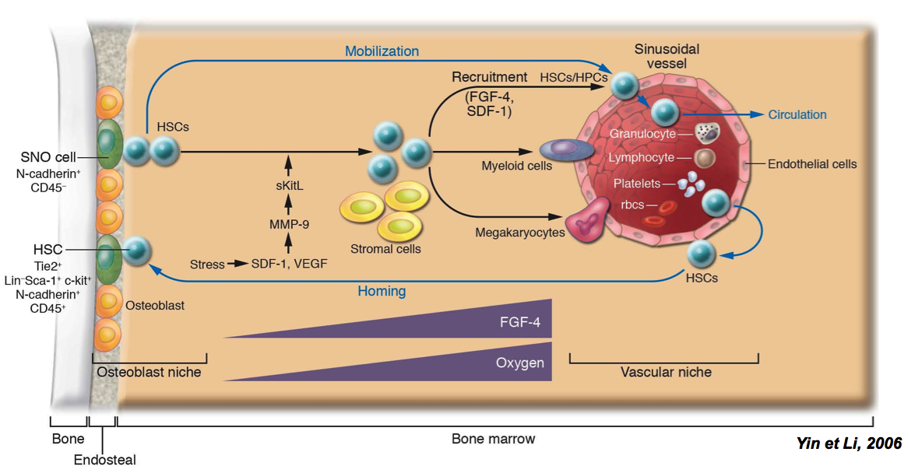
Endosteal versus vascular HSC niche
Yin and Li, 2006
Notes:
23
My PhD was done in a new team created in the institut pasteur called Human Histopathology and animal models unit
This unit is particular because studying not a cell type in particular but cell interactions at the tissue level.
Of course you all know that complex tissues host different resident specialized cell types: stromal compartment, as well as stem cells located in a niche. Interactions between all these cell types are a pre requisit for tissue homeostasis.
23

Slide 24
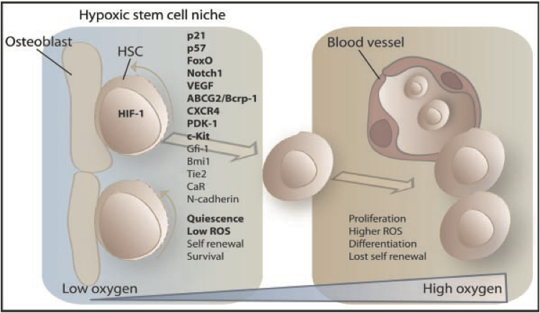
Endosteal versus vascular HSC niche

Slide 25
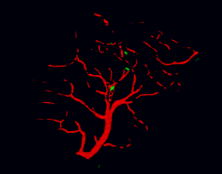
Hypoxic satellite cell niche?
Vessels Myf5^{GFP} Satellite cells
Vessels Myf5^{GFP} Satellite cells
Looking at Satellite cells in severe hypoxia/anoxia
Notes:
As previously described by different teams, muscle stem cells are heterogeneous, both at the molecular level and regarding their location in the tissue.
Previous work from the lab demonstrates that most of the satellite cells are located very close to blood vessels and are therefore exposed to high concentrations of oxygen but a minority of them are more distant from vessels and are less exposed to oxygen.
So, we have done a parallel with the bone marrow where two niches were described: a normoxic vascular niche for maturation and an hypoxic osteoblastic niche for quiescence.
We decided then to investigate sat cell behaviour in low oxygen condition and for this purpose we looked at a very dramatic scenario of hypoxia: the death.

Slide 26
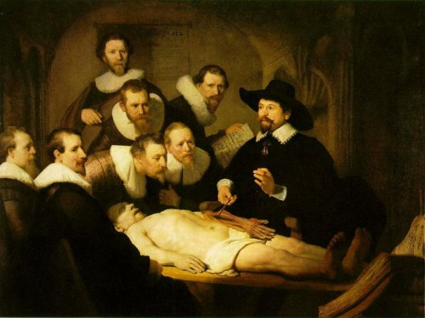
Histology of human cadaver muscle
La leçon d’anatomie du Dr Tulp, Rembrandt
Notes:
So we established a collaboration with the centre des dons du corps of the Paris Descartes University and and obtained 16 human cadavers, of individuals ranging in age from 57 to 95 yo - males and females.
We then removed biopsies from 6 to 17 days after death. The cadavers were kept at 4°C.
At the histological level, the muscle tissue is very severely affected and autolytic as expected. All of the myofibers were oedematous with leaky nuclei. In this very hostile environment we still observe some small cells with a darker and more compact appearance expressing CD56 - a human Sc marker.

Slide 27
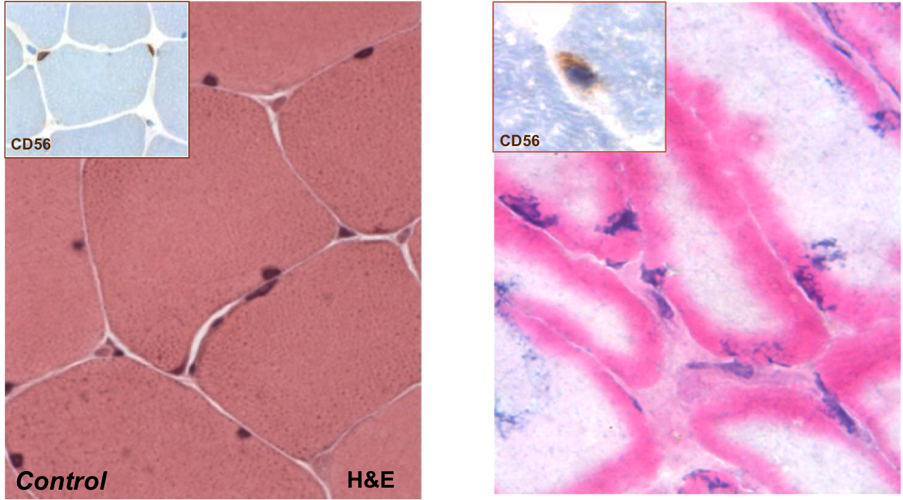
Histology of human cadaver muscle
Notes:
So we established a collaboration with the centre des dons du corps of the Paris Descartes University and and obtained 16 human cadavers, of individuals ranging in age from 57 to 95 yo - males and females.
We then removed biopsies from 6 to 17 days after death. The cadavers were kept at 4°C.
At the histological level, the muscle tissue is very severely affected and autolytic as expected. All of the myofibers were oedematous with leaky nuclei. In this very hostile environment we still observe some small cells with a darker and more compact appearance expressing CD56 - a human Sc marker.

Slide 28
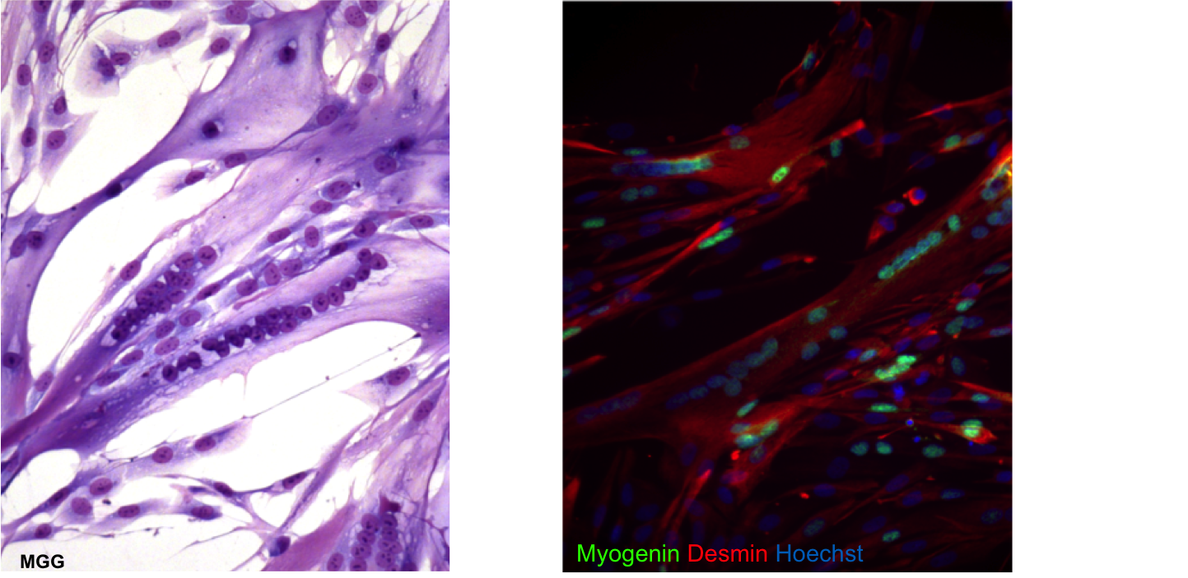
Histology of human cadaver muscle
Notes:
So we established a collaboration with the centre des dons du corps of the Paris Descartes University and and obtained 16 human cadavers, of individuals ranging in age from 57 to 95 yo - males and females.
We then removed biopsies from 6 to 17 days after death. The cadavers were kept at 4°C.
At the histological level, the muscle tissue is very severely affected and autolytic as expected. All of the myofibers were oedematous with leaky nuclei. In this very hostile environment we still observe some small cells with a darker and more compact appearance expressing CD56 - a human Sc marker.

Slide 29
Histology of human cadaver muscle
Notes:
So we established a collaboration with the centre des dons du corps of the Paris Descartes University and and obtained 16 human cadavers, of individuals ranging in age from 57 to 95 yo - males and females.
We then removed biopsies from 6 to 17 days after death. The cadavers were kept at 4°C.
At the histological level, the muscle tissue is very severely affected and autolytic as expected. All of the myofibers were oedematous with leaky nuclei. In this very hostile environment we still observe some small cells with a darker and more compact appearance expressing CD56 - a human Sc marker.

Slide 30
Survival of muscle stem cells in a muscle sample
organ donors samples
Muscle biopsy
4°C several days
Culture
 |  | D2 |  | D4 |  | D10 |  | D20 |  | D25 |  | D30 |  | D35 |  | D40 |  | D50 |  | D60
F 56 y.o. |  | + |  | + |  | +
F 58 y.o. |  | + |  | + |  |  |  |  |  |  |  |  |  |  |  | - |  | - |  | -
F 43 y.o. |  |  |  |  |  | + |  |  |  |  |  |  |  | - |  |  |  | - |  | -
M 50 y.o. |  |  |  |  |  |  |  |  |  |  |  |  |  | - |  |  |  |  |  | -
F 59 y.o. |  | + |  | + |  |  |  |  |  |  |  |  |  | -
F 57 y.o. |  | + |  | + |  |  |  | + |  | + |  |  |  | - |  | -
F 74 y.o. |  |  |  |  |  | + |  |  |  |  |  |  |  |  |  | -
M 69 y.o. |  |  |  |  |  | + |  | + |  | + |  | +
M 55 y.o. |  |  |  |  |  |  |  |  |  |  |  |  |  |  |  |  |  | - |  | -
F 43 y.o. |  |  |  |  |  | + |  | + |  |  |  | - |  | -
M 65 y.o. |  |  |  |  |  | + |  |  |  | + |  | - |  |  |  | -
M 54 y.o. |  |  |  |  |  |  |  |  |  |  |  |  |  |  |  | -
M 55 y.o. |  |  |  |  |  |  |  | + |  | + |  | -
F 41 y.o |  |  |  |  |  |  |  |  |  |  |  |  |  |  |  | -
F 77 y.o |  |  |  |  |  |  |  | + |  | + |  |  |  | -
Notes:
Because we were not able to obtain cadavers for a longer period than than 17 days after death, we stored muscle biopsies at 4°C for extended periods in a minimum medium with antibiotics.
As you can see in this table until day 25 and even 30 we were able to obtain myoblasts. After this period, cells from the biopsies failed to grow.

Slide 31
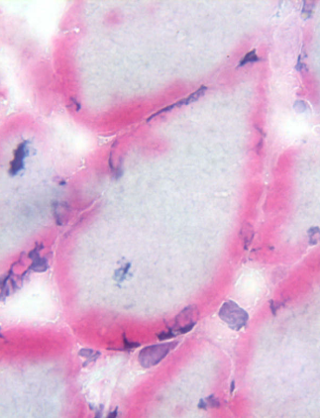
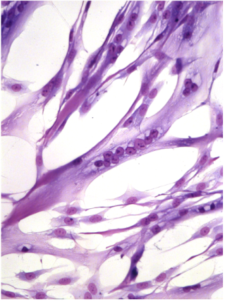
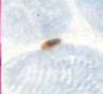
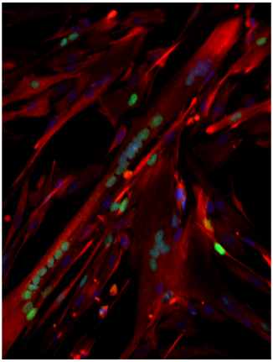
Survival of muscle stem cells in a muscle sample
CD56
H&E
MGG
Myogenin Desmin Hoechst
From a patient F 69 y.o. 30 days post sampling
Notes:
Also in this model the muscle tissue becomes autolytic and after 30 days cell architecture is unrecognisable. Interestingly these cells were perfectly functional in vitro, as they formed myotubes expressing myogenic markers

Slide 32
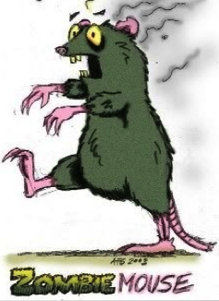
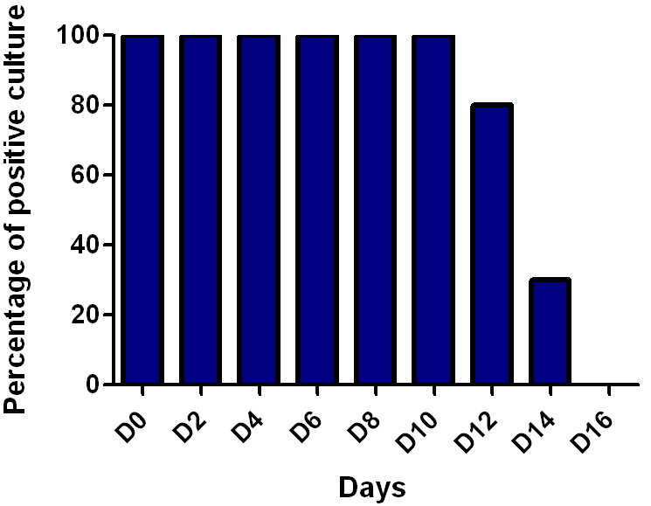
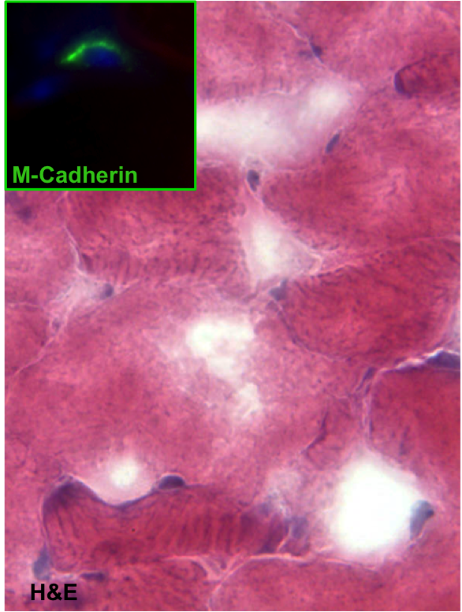
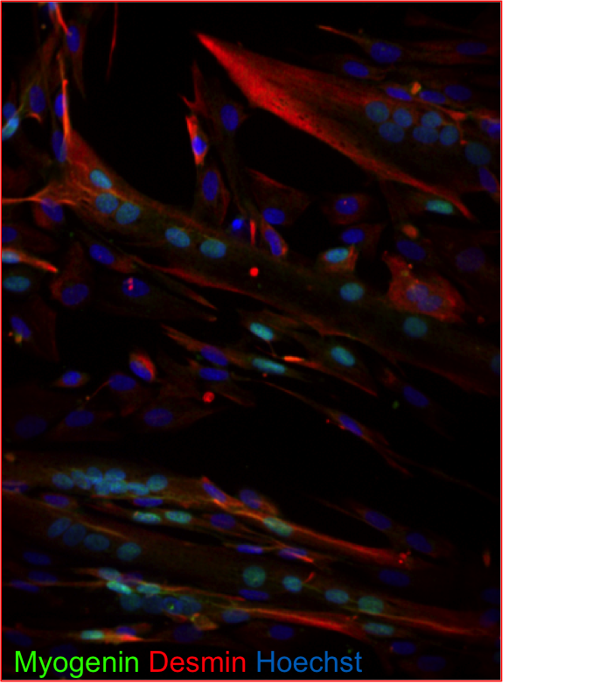
Survival of muscle stem cells in a mouse cadaver
CO2 (Death)
Culture
4°C many days
Muscle bulk
C57Bl6
8 days post mortem mouse cadaver
Notes:
Then we decided to move to the mouse to investigate this experimental model in details.
In the mouse, we observed the same phenomenon.
We obtained SatC up to day 14 post mortem. After this time we still obtain cells but a lot of our cultures were contaminated due to bacterial proliferation in the cadavers.

Slide 33
Satellite cells functionnality in vitro
Myotubes arising from cells obtained 4 days post mortem
Notes:
This cells are perfectly fonctionnal in vitro as you can see in this video of contracting myotubes arising from cells obtained 4 days pm

Slide 34
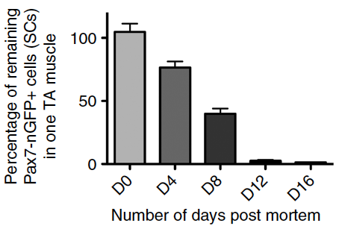
How many satellite cells survive in a muscle
post mortem?
Tg:Pax7nGFP
4°C many days
SCs count, sorting and culture
Tibialis anterior
CO₂ (death)
Notes:
Next we asked how many cells can survive in this very hostile post mortem environment?
In fact, by taking advantage of transgenic mice Tg:Pax7-nGFP developed in ST lab we decided to count satC in one tibialis anterior muscle after different times post mortem.
After 12 days p.m. more than 98% of the cells were lost, however 4 days p.m. only about 25% of the initial number of SAtCs was lost.

Slide 35
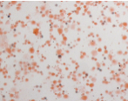
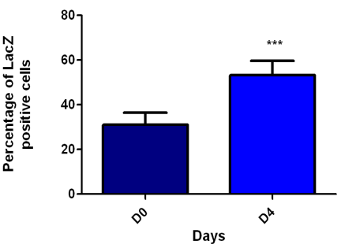
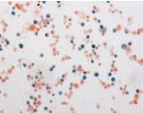
Purification of stem cells after death
D0
% X-Gal + cells
CO₂ (death)
0 day
4 days
D4 pm
Pax7^{nLacZ/+}
Notes:
Interestingly, we noticed that it is mainly the SatCells that stay alive after death of the animal.
As illustrated here if you compare the percentage of the SatC that we obtained after a bulk muscle digestion between day 0 and day 4 post mortem - we obtained 2 fold enrichment of SatC in the cell preparation 4 days after death.

Slide 36
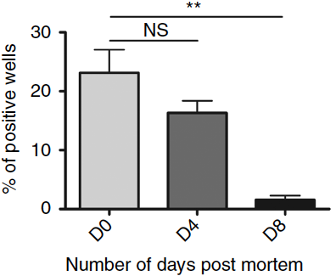
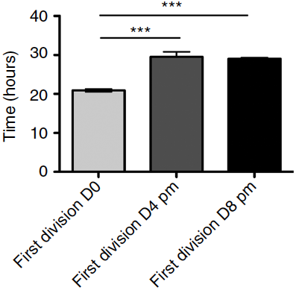
Purification of stem cells after death
Satellite cells have selective advantage to survive in post mortem conditions
Same clonal capacity between
D0 and D4 post mortem
Delay in 1st cell division
Notes:
Interestingly, we noticed that it is mainly the SatCells that stay alive after death of the animal.
As illustrated here if you compare the percentage of the SatC that we obtained after a bulk muscle digestion between day 0 and day 4 post mortem - we obtained 2 fold enrichment of SatC in the cell preparation 4 days after death.

Slide 37
Quiesence and post mortem survival
Tg:Pax7nGFP
Tg:Pax7nGFP::Mdx
Tg:Pax7nGFP
CO2
CO2
CO2
LPS
Notexin
Skuk, 2004
4 days post mortem: Satellite cells count in one TA muscle
Quiescence confers viability to post mortem stem cells
LPS mdx NTX
Notes:
Then, we perform a characterisation of these stem cells that survive in post mortem conditons.
Clonal analysis of this resisting muscle stem cells showed no significant difference in their ability to generate progeny between D4 post mortem and freshly isolated cells. However, this value dropped markedly at 8 days post mortem.
Notably, they need more time to exit from quiescence and we observe, a delay in the first mitosis. These cells post mortem seems to be in a deeper state of quiescence than freshly isolated cells. In spite of this delay, after the first division, myogenic cells divided synchronously every 7h in both conditions without any observable phenotypic differences indicating that this lag observed with post mortem animals is reversible.
To assess the commitment status of the muscle stem cells post mortem, we performed RT–qPCR and observed that sat cells post mortem are in a more quiescent state than freshly isolated cells.
We then think that the quiescent state might confer a survival advantage to the stem cells.
To answer to this question we formed three different cohorts of mice, in which satellite cells are activated by different experimental paradigms and then examined 4 days post mortem:
In the first cohort, mice were injected with bacterial LPS to induce severe acute systemic inflammation.
In the second cohort, we used a mouse model of duchenne muscular dystrophy, the mdx mouse, characterized by chronic regeneration.
Finally, in the third cohort, we use a severe muscle injury using a myotoxic agent.
For memory, the percentage of remaining satellite cells from uninjured TA muscle of Tg:Pax7-nGFP mice between 0 and 4 days post mortem was 76%.
In all these cohorts, we can see that the number of resisting satellite cells in post mortem conditions drop dramatically compared with the untreated mice 4 days post mortem.
Taken together, these experiments suggest that the post mortem cells are in a deeper cellular quiescence, which, in part, protects stem cells from death in post mortem tissue.

Slide 38
Characterisation of stem cells that survive after death
Reduced oxygen consumption
Decrease of ATP level
Same redox status
Increase of ROS level
Notes:
To investigate further the mechanisms associated with muscle stem cell survival, we compared oxygen consumption, ATP level and NAD/NADH ratio between fresh and 4 days post mortem satellite cells.
All these experiments demonstrate a very low metabolic activity of post mortem cells.
Interestingly and surprisingly, the level of Reactive oxygen species is 8 fold more important in 4 days post mortem cells compared to freshly isolated cells.

Slide 39
Characterisation of stem cells that survive after death
Notes:
39
My PhD was done in a new team created in the institut pasteur called Human Histopathology and animal models unit
This unit is particular because studying not a cell type in particular but cell interactions at the tissue level.
Of course you all know that complex tissues host different resident specialized cell types: stromal compartment, as well as stem cells located in a niche. Interactions between all these cell types are a pre requisit for tissue homeostasis.
39

Slide 40
In vitro anoxia modelization: GENbag Anaer
Notes:
40
My PhD was done in a new team created in the institut pasteur called Human Histopathology and animal models unit
This unit is particular because studying not a cell type in particular but cell interactions at the tissue level.
Of course you all know that complex tissues host different resident specialized cell types: stromal compartment, as well as stem cells located in a niche. Interactions between all these cell types are a pre requisit for tissue homeostasis.
40

Slide 41
In vitro anoxia modelization: GENbag Anaer
Notes:
41
My PhD was done in a new team created in the institut pasteur called Human Histopathology and animal models unit
This unit is particular because studying not a cell type in particular but cell interactions at the tissue level.
Of course you all know that complex tissues host different resident specialized cell types: stromal compartment, as well as stem cells located in a niche. Interactions between all these cell types are a pre requisit for tissue homeostasis.
41

Slide 42
Are these Satellite cells functional in vivo ?
Graft with post mortem satellites cells
Rag^{-/-} ::γc^{-/-}
Histology
D0 Graft
D-1
CTX
Tg:Pax7-n^{GFP-P/+}::Tg:MLC3F-nlacZ-2E
D30
X-gal
X-gal
Control (freshly isolated cells) 4 days post mortem
Notes:
Then we wanted to test if these SatC that remain alive in a dead organism many days after death and that are functional in vitro are also functional in vivo.
We perform muscle transplantation of SatCells from transgenic PAX7GFP::MyosinlacZ cadavers in a preinjured muscle of immunocompromised mice.
Macrospically we can see that we obtain a very robust muscle engraftement with cadaver cells.

Slide 43
Are these Satellite cells functional in vivo ?
Graft with post mortem satellites cells
Rag^{-/-} ::γc^{-/-}
or
mdx
Histology
D0 Graft
Tg:Pax7-n^{GFP-P/+}::Tg:MLC3F-nlacZ-2E:: CAG-PLAP
D-1
CTX
D30
D4 pm
D8 pm
PLAP Laminin Hoechst
Dystrophin Hoechst
Notes:
At the microscopic level these cells were perfectly able to reform muscle fibers in a preinjured muscle that was undergoing regeneration.
In addition, these cells were also able to reform dystrophin positive myofibres in a mouse model with a dystrophin deficiency, the Mdx mouse.

Slide 44
Are these Satellite cells functional in vivo ?
Graft with post anoxia satellites cells
Rag^{-/-} ::γc^{-/-}
or
mdx
Histology
D0 Graft
Tg:Pax7-n^{GFP-P/+}::Tg:MLC3F-nlacZ-2E:: CAG-PLAP
D-1
CTX
D30
Notes:
At the microscopic level these cells were perfectly able to reform muscle fibers in a preinjured muscle that was undergoing regeneration.
In addition, these cells were also able to reform dystrophin positive myofibres in a mouse model with a dystrophin deficiency, the Mdx mouse.

Slide 45
Are these Satellite cells functional in vivo ?
Rag^{-/-} ::γc^{-/-}
or
mdx
Histology
D0 Graft
Tg:Pax7-n^{GFP-P/+}::Tg:MLC3F-nlacZ-2E:: CAG-PLAP
D-1
CTX
D30
Notes:
At the microscopic level these cells were perfectly able to reform muscle fibers in a preinjured muscle that was undergoing regeneration.
In addition, these cells were also able to reform dystrophin positive myofibres in a mouse model with a dystrophin deficiency, the Mdx mouse.

Slide 46
Mitochondrial study
Notes:
46
My PhD was done in a new team created in the institut pasteur called Human Histopathology and animal models unit
This unit is particular because studying not a cell type in particular but cell interactions at the tissue level.
Of course you all know that complex tissues host different resident specialized cell types: stromal compartment, as well as stem cells located in a niche. Interactions between all these cell types are a pre requisit for tissue homeostasis.
46

Slide 47
Mitochondrial study
Notes:
47
My PhD was done in a new team created in the institut pasteur called Human Histopathology and animal models unit
This unit is particular because studying not a cell type in particular but cell interactions at the tissue level.
Of course you all know that complex tissues host different resident specialized cell types: stromal compartment, as well as stem cells located in a niche. Interactions between all these cell types are a pre requisit for tissue homeostasis.
47

Slide 48
Mitochondrial study
Same organization of
mitochondrial network
Decrease in mitochondrial mass
in post mortem satellite cells
Notes:
Then we studied the mitochondrial status of the resisting satellite cells.
It’s interesting to notice that the organisation of the mitochondrial network is the same, but the mass and their activity is clearly dimisnished.
In a reaction to this cell stress, mitochondrial increase their level of DNA.

Slide 49
Mitochondrial study
Decrease of mitochondrial transcripts
Decrease of SOD enzymes
Difference in mitochondrial DNA content
Notes:
Then we studied the mitochondrial status of the resisting satellite cells.
It’s interesting to notice that the organisation of the mitochondrial network is the same, but the mass and their activity is clearly dimisnished.
In a reaction to this cell stress, mitochondrial increase their level of DNA.

Slide 50
Is it also the case for hematopoietic stem cells ?
0 day post mortem 2 days post mortem 4 days post mortem
C57BL/6
Flow Cytometry
evaluation
9,5 Gy
6 w.o.
28 days
Birth
GFP⁺ Cells
BMT
CAG-GFP
cadaver bone marrow
Notes:
At the end, we asked if this observation can be also the case for other stem cell and we choose to study hematopoietic stem cells.
Rapidly after the death, bone marrow become very autolytic even a few days post mortem.
We examined the functionnality in vivo of HSC by doing BM transplantation with actin GFP cadaver bone marrow into lethally irradiated animals.

Slide 51
Transplantability of post mortem bone marrow
Direct transplantation
Serial transplantation
Immunophenotyping of GFP+ cells
B220
91,6%
CD5
59,07%
%chimerism (GFP+ cells)
PE
Gr1
59,07%
CD11b
72,21%
Days post mortem
GFP
Notes:
If you take the bone marrow of two femurs even 4 days after death we can obtain bone marrow reconstitution, even after serial transplantations.
In addition after immunophenotyping of GFP positives cells, we can see that all the blood lineage (the B and T lymphocytes, the granulocytes and monocytes/macrophages were reconstituted.

Slide 52
Transplantability of post anoxia bone marrow
Immunophenotyping of GFP+ cells
B220
90,8%
CD5
31,8%
Direct transplantation
Serial transplantation
PE
Gr1
79,6%
CD11b
91,5%
Percentage of chimerism
(GFP positive cells) post graft
GFP
Days in anoxia at 4°C
Notes:
We obtain the same results when the bone marrow was stored in anoxia during different times.
Even if after 3 days in anoxia, 95% of cells are lost, with the little fraction of remaining cells, in all the cases, we succed to reconstitute the bone marrow of irradiated mice even aftef serial transplantation.
In this case also, all the blood lineage were reconsituted.

Slide 53
Summary
Muscle Satellite cells as well as Hematopoietic stem cells are able to resist many days after death
They remain functional both in vitro and in vivo
They adopt a dormant state in post mortem conditions and in anoxia
This opens the possibility of a novel source of stem cells for therapeutic purposes and also a very interesting model for understanding the properties of stem cells.
Notes:
To summerize our results, we have shown that muscle Satellite cells as well as Hematopoietic stem cells are able to resist many days after death
They remain functional both in vitro and in vivo
They adopt a dormant state in post mortem conditions and we can induced this dormant state in vitro with anoxia
This opens the possibility of a novel source of Stem cells for therapeutic purposes and also a very interesting model for understanding the properties of stem cells.

Slide 54
Acknowledgments
Experimental Neuropathology :
Fabrice Chrétien
Patrick Avé
Nathalie Djebara
Laurence Fiette
Patricia Flamant
David Hardy
Grégory Jouvion
Huot Khun
Claire Latroche
Sabine Maurin
Stem cells and develpment:
Shahragim Tajbakhsh
Barbara Gayraud Morel
Jeanne Matondo
Aurélien Mazeraud
Miryam Mebarki
Fanny Mérard
Virginie Piccicuto
Pierre Rocheteau
Tarek Sharshar
Romain Sonneville
Tung Jui Trieu
Franck Verdonk
labo:
Miria Ricchetti
Laurent Chatre
Faculté de Médecine, Paris Est Créteil
Adeline Henry / Aurélie Guguin

