Slide 1
Vaccins anti-VIH: un défi!
Vaccins anti VIH : un développement complexe
….et extraordinairement difficile!
        Marc Girard, Professeur honoraire Université Paris Diderot et Institut Pasteur, Membre émérite de l’Académie Nationale de Médecine
        Roger Le Grand, Directeur de Recherches INSERM, Directeur du Centre de Primatologie du Centre de l’Energie Atomique, Fontenay aux Roses

Slide 3
Quelques chiffres
On a dénombré, en 2016, une nouvelle infection HIV-1 dans le monde toutes les 17 secondes, soit 5000 nouvelles infections par jour
→ 1,8 millions de nouvelles infections dans l’année
En 2016 aussi, on dénombrait 36,7 millions de personnes vivant avec le VIH dans le monde.
Mais seules 19,5 millions d’entre elles avaient accès à un traitement antirétroviral (ART)
La mortalité due au SIDA a été de 1 million de personnes en 2016
(Elle était de plus de 2 millions de personnes/an au début de la décennie)

Slide 4
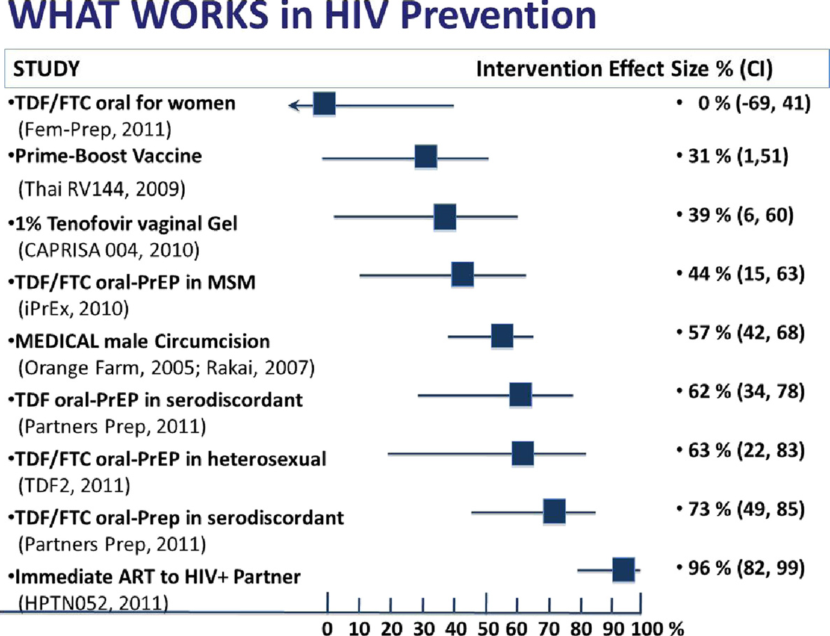

Slide 5
Why don’t we have a vaccine against HIV?
No-one has ever recovered from HIV infection
HIV is a rapidly moving target
Diversity of mechanisms of transmission
HIV integrates into human DNA
It is difficult to neutralize HIV (complex surface envelope glycoprotein)
Current vaccines are unable to stimulate broadly neutralizing antibodies

Slide 6
Le VIH échappe aux défenses immunitaires de l’hôte
Le virus a développé plusieurs stratégies d’échappement :
  Il persiste à l’état masqué (« provirus latent») dans des « cellules réservoir » (les lymphocytes T mémoire)
  Il mute constamment, échappant ainsi aux anticorps et aux CTL
  Il génère une hyperstimulation du système immunitaire, qui conduit à l’épuisement de ce dernier, sans parler de la destruction des lymphocytes T4 dans lesquels il se réplique
  Il provoque l’effacement des marqueurs (HLA) de surface de la cellule infectée, lui permettant ainsi d’échapper à la surveillance par les CTL

Slide 7
Diversité et variabilité du VIH-1
Quasiespèces
Chez un même patient
Recombinaison
(Troyer et al, 2005)
(Lal et al, 2005)

Slide 8
Diversité et variabilité du VIH-1 au sein d’une population

Slide 9
HIV-1 Variability
HIV-1 is subdivided into 4 groups: M (pandemic), N and O, the three of which are related to SIV cpz, and group P, recently identified, which is related to SIV gor (Plantier, Nat Med 2009);
Group M , which is the most prevalent worldwide, can be subdivided into 10 subtypes, or clades (A, B, C, D,…), and a variety of « recombinant forms » or « CRFs » (CRF01_AE in SE Asia; CRF02_AG in West Africa; CRF07 and 08_BC in China…)
Amino acid sequence of the Env glycoprotein shows 25-35% divergence between clades in group M and up to 20% divergence between isolates from the same clade: a formidable challenge to vaccine development!

Slide 10
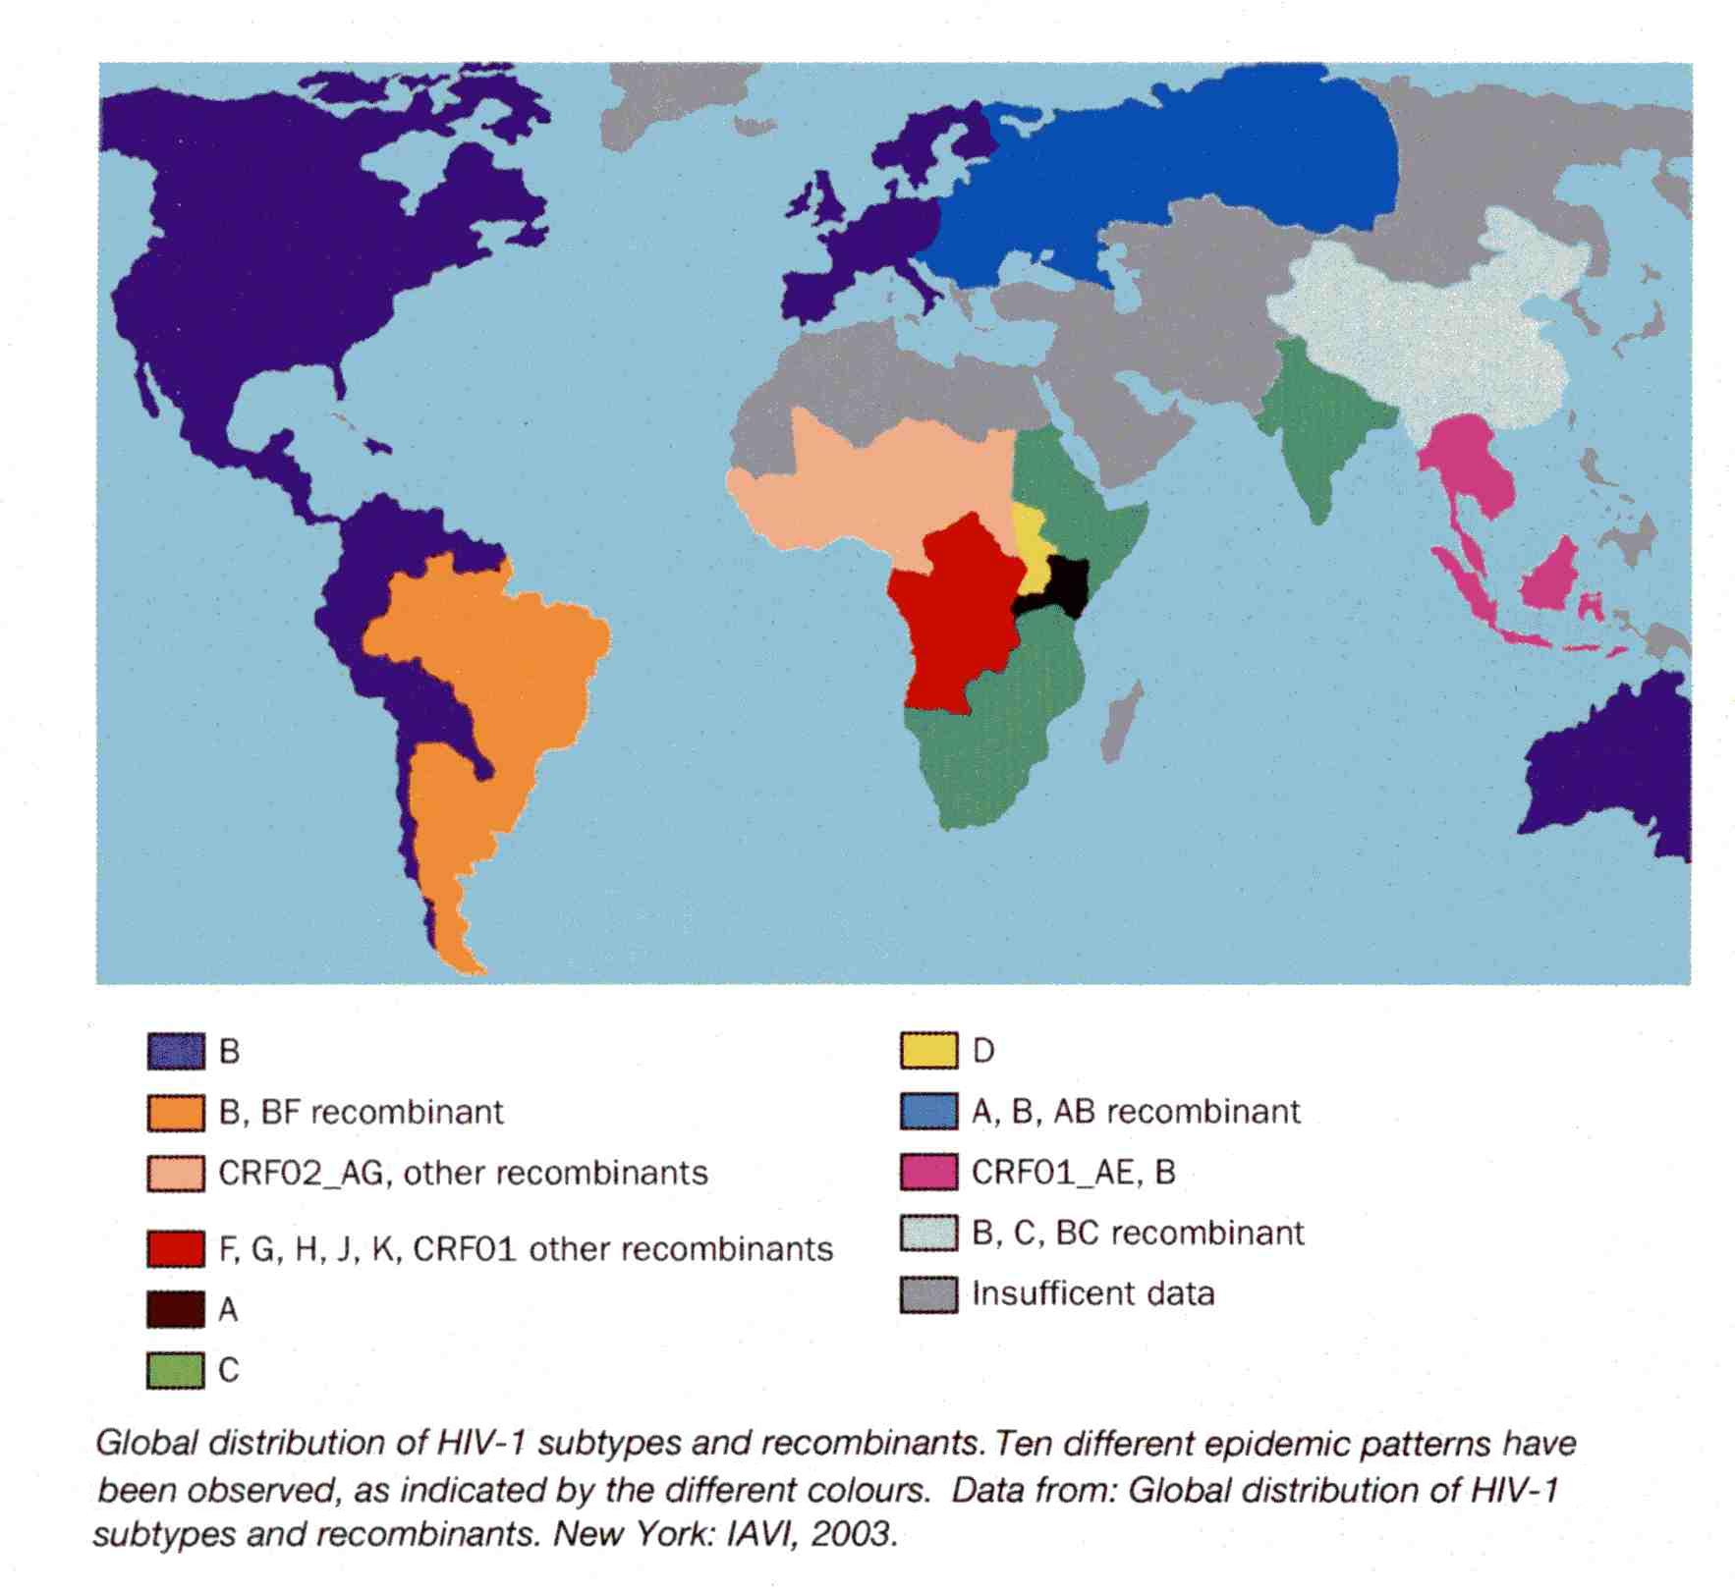

Slide 11
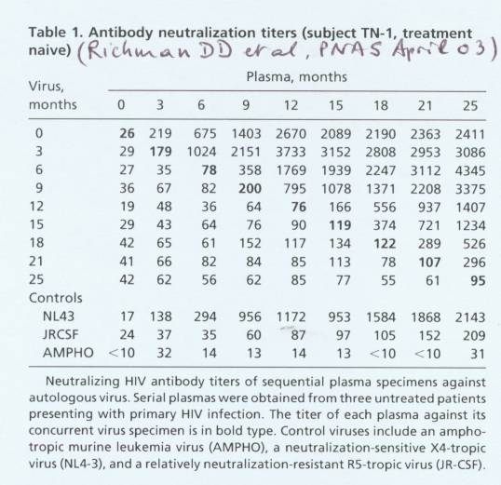

Slide 12
Autre difficulté: les modèles animaux sont imparfaits
The chimp model: HIV-1 ‘ takes’ in chimpanzees → the animals seroconvert and remain viremic but do not develop any sign of immunodeficiency!
The macaque model: HIV-1 does not infect macaques. Hence the need to either develop SIV vaccines and use the SIV / macaque model; or to develop HIV-SIV chimeric viruses (« SHIVs ») which grow in rhesus macaque monkeys and carry the enveloppe spike of HIV-1 (and its antigenicity) in a SIV genetic backbone
The humanized mouse model: knock-out mice devoid of a mouse immune system but grafted with human cells from the bone marrow, liver and thymus from human embryos (« BLT mice »)
« Mice lie and monkeys exagerate »→ « ALL MODELS ARE WRONG BUT MOST ARE USEFUL! »

Slide 13
Obvious consequence
The only way to test an HIV vaccine is in human volunteers :
→ Phase III (or Phase IIb) clinical trials
But this implies:
To select a population at risk (drugs users, prostitutes, gays)
To determine the infection incidence (>1%/an)
To determine the number of volunteers required (16,000 in the case of the RV144 trial)
To determine the duration of the study (4.5 years for RV144)
To recruit the appropriate volunteers
Consequences: To develop a HIV Vaccine is a major endeavior, a long-lasting, complex, difficult, and very expensive process.

Slide 14
Les essais vaccinaux de Phase III depuis 1983
1/ Vaxgen (Etudes Vax 003 et Vax 004) à base de gp120:
→ 0 protection
2/ Merck (Etude STEP) à base d’Ad5 recombinant:
→ 0 protection
3/ NIH (Etude HVTN 505) à base de DNA + Ad5 recombinant:
  → 0 protection
4/ Sanofi (Etude RV144) à base de canarypox recombinant (ALVAC) + gp120: → protection 31%
5/ Plusieurs nouveaux essais ont été lancés en 2016-17; d’autres vont être lancés en 2018.

Slide 15
The quest for an AIDS vaccine started with
Env vaccines (Induction of NAbs)
Early 1990s: recombinant gp120 or gp140 env subunit vaccines alone or in association with V3 peptides were shown to protect chimpanzees against homologous HIV-1 challenge using an « X4 » (TCLA) virus strain (Berman et al, Nature 1990; Fultz et al, Science 1992)
They could not, however, protect the animals against heterologous challenge (HIV-1 DH2; CRF A-E vs clade B) because of the restricted specificity of the neutralizing antibodies elicited by the vaccines
(Girard et al, J Virol 1995 and 1996; Mascola et al, J Infect Dis 1996).

Slide 16
First Phase III clinical trials
In spite of the limited protection observed in chimpanzees, VaxGen decided to test the concept of gp120 vaccines in two Phase III trials:
    Vax003 in the Americas with a mixture of two gp120 clade B
    Vax004 in Thailand with a mixture of gp120 clade B and CRF A-E
    (both with alum as an adjuvant)
    Both trials showed gp120 was unable to provide protection against HIV infection

Slide 17
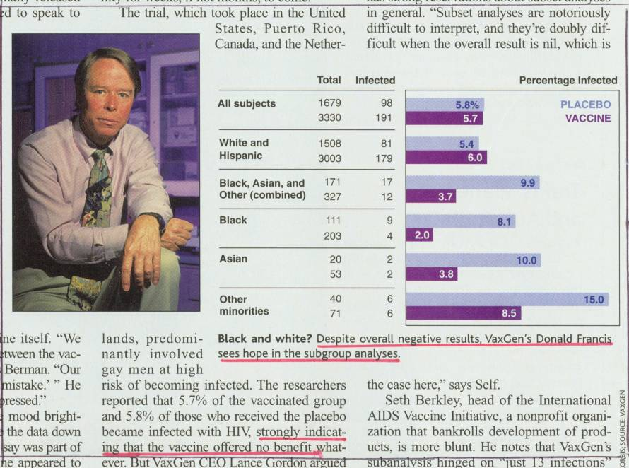

Slide 18
II. Could T cell responses be an alternative?…
Initial demonstration of the protective role of CD8+ T cells in the SIV / macaque model : depletion of CD8+ T cells by anti-CD8 Mabs in SIV-infected animals → immediate, large increase in virus load and accelerated disease progression leading to premature death (Schmitz, Science 1999; Letvin, Immunity 2007)
Immunization of macaques with attenuated live SHIV 89.6 or with attenuated SIV Δnef elicits protection against intravaginal SIV challenge.
Protected animals showed polyfunctional, degranulating, SIV-specific CD4+ and CD8+ T cells in the vaginal mucosa (Genescà, Mucosal Immunol 2008 and J Intern Med 2009)
Depletion of CD8+ T cells (by injection of an anti-CD8 Mab) completely abrogated protection → protection from vaginal SIV challenge was indeed mediated by effector CD8+ T cell responses (Genescà, J Virol 2008)

Slide 19
T cell reponses in seropositive humans
Human « elite controllers », whose viral load remains <75 copies/mL in the absence of antiviral treatment, show potent, multi- functional, viral infection- suppressing CD8+ CTL responses (Almeida, J Exp Med 2007; Migueles, Immunity 2008)
Polyfunctional CD8+ T cells are also found in HIV controllers (<2000 copies/mL), including in mucosal tissues. Controllers frequently have a B27, B52 or B57 HLA haplotype (Betts, Blood 2006; Saez-Cirion, PNAS 2007; Emu J Virol 2008; Ferre, Blood 2009). Similarly, protective haplotypes have been described in monkeys (MHC Mamu B08, Mamu B17…).
HIV-specific CD8+ CTL were initially found in the cervical tissue in HIV-1-exposed, persistently seronegative (‘HEPS’) commercial sex workers (Rowland-Jones, 2000).

Slide 20
The Merck Ad5-HIV gag, pol, nef
Phase IIb « STEP » trial
An Ad5-HIV gag,pol, nef vaccine was administered three successive times to volunteers at risk.
The trial however had to be prematurely stopped because of an increased number of infections in the uncircumcised volunteers with previous immunity to the Ad5 vector :
29/532 infections reported in the Ad5-HIV vaccinated group vs 13/528 in the placebo group (Schoenly , Weiner J Virol 2008)
The reason for this facilitation phenomenon remains unclear (Sekaly, J Exp Med 2008; Watkins, Nat Med 2008; O’Brien, Nat Med 2009 ; Hutnick, Nat Med 2009)
Quite surprizingly, the Ad5 vaccine elicited no decrease in viral loads in the vaccinees who got infected, in spite of a measurable T cell response !

Slide 21
Failure of the « STEP » trial
The Merck Ad5 vaccine had been tested in the macaque/ SHIV model, where it showed some efficacy at controlling viral loads when the challenge virus was SHIV 89.6P, an X4 SHIV.
It however showed no efficacy when tested in the more demanding macaque/SIV model (Casimiro, J Virol 2005; Mattapallil , J Med Primatol 2006; Suh, Vaccine 2006; Wilson, J Virol 2007)
Indeed, the Ad5 vaccine elicited IFN-γ-secreting, circulating T cells, but protection in NHP models does not correlate with PBMC IFN-γ ELISPOT (Zhou, Vaccine 2007; Mansfield , J Virol 2008) , it needs high affinity, high-avidity, multi-cytokine T cell responses (Abel, J Virol 2003; Betts, Blood 2006; Belyakov, J Immunol 2007; Saez-Cirion , PNAS 2007; Almeida, J Exp Med 2007; Sui et al, Proc Nat Acad Sci USA 2010).
Protective T cells stain positive for IL-2, TNF, MIP-1β, IFN-γ and granzyme; and they actively suppress viral replication through cell killing . The Merck recombinant Ad5 vaccine was not able to elicit this type of a T cell response.

Slide 22
Other live vectored vaccines
Adenoviruses:
After the failure of the STEP trial, Ad5 will never be used again.
Still some hope in Ad26, Ad35 and Chimp Ad 3, especially if they express mosaic antigens.
Pox viruses:
Vaccinia (MVA, NYVAC); Fowlpox; Canarypox (ALVAC).
→ CD4 cellular immune responses > CD8 cellular immune responses
Venezuelan Equine Encephalitis (VEEV);
Adeno-associated virus (AAV) → weakly immunogenic
Others: Measles (MV), Rubella virus, Stomatite vésiculaire (VSV) …

Slide 23
DNA vaccines
Naked DNA (→ Cellular immune responses (CD4>CD8), after multiple immunizations)
Adjuvanted DNA : CRL005, IL-15, IL-12 (→ No significant enhancement detected)
Delivery by electroporation → Electroporation greatly enhances DNA immunogenicity
As stand-alone candidates, DNA vaccines have generally been less immunogenic in humans compared with small animal or NHP.
Their major interest lies in prime-boost immunization regimens:
DNA + live vectored vaccine (MVA, Ad26…) ; DNA + protein vaccine (gp120; SOSIP)

Slide 24
Prime-boost immunization regimens
Canarypox prime + gp120 (RV 144 trial in Thailand) : ALVAC-HIV + gp120 B/E
Ad35 prime + gag-pol-nef fusion protein (AS01B); Ad26 prime + gp140 (mosaic Ag) boost
DNA + MVA; DNA + NYVAC (Both induce multifunctional CD4+ >CD8+ T cells)
DNA + gp120 (elicits binding Ab, ADCC, neutralizing Ab against Tier 1 isolates)
Ad26 prime + Ad35 boost
MVA prime + Ad35 (or Ad26) boosts
Ad26 prime + MVA boost
Vaccine clinical trials database www.iavi.org,

Slide 25
The RV144 Phase III trial
ALVAC-HIV env, gag, pol + gp120 clade E: prime-boost regimen tested on 16,400 volunteers in Thailand : 51 infections in the vaccinated group versus 74 in the placebo group, i.e. a statistically significant 31% reduction in the number of infections.
  Protection actually was 61% at year 1 and appeared to progressively wane with time
  There were no detectable CD8+ CTL responses (no cellular immunity effect). Low titer NAbs were irregularly detected in some vaccinees.
  The basis of protection was therefore neither CMI responses nor NAbs!

Slide 26
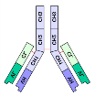
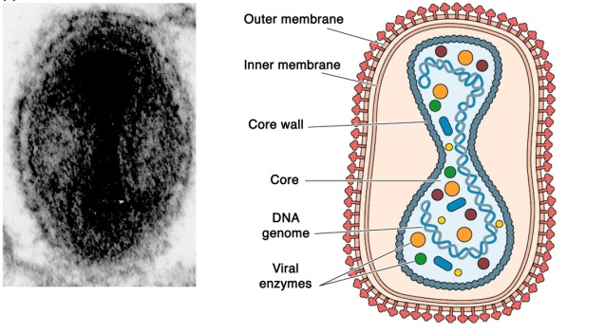
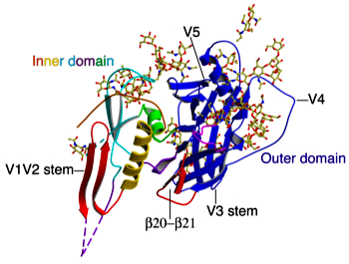
+
+
16,395 Volonteers
18-30 Years
12,542 Completed study
$105 Million

Slide 27
RV144 : 31.2% Reduction of Infection risk
P=0.04

Slide 30
New surrogate markers of protection
The RV144 trial showed correlation between protection and IgGs that target the C1 domain of gp120 and promote ADCC.
It also demonstrated a clear correlation between protection and V1-V2 targeted IgGs.
ADCC (Antibody-dependent cellular cytotoxicity ) occurs when an Ab molecule bound by its Fab segment to a cognate viral Ag on the surface of an infected target cell interacts through its Fc portion with the Fc receptor of an effector cell ( NK cell, monocyte), leading to death of the target cell
Antibody-dependent cell-mediated viral inhibition (ADCVI) is similar to ADCC but the read-out is the inhibition of virus production rather than the death of the target cell
(Hessel, Nature 2007; Forthal & Moog, Curr Opin HIV AIDS 2009; Perez, J Virol 2009; Moldt J Virol 2011 and 2012)

Slide 31
ADCC/ADCVI activities in passive immunization NHP models
Le rôle de l’ADCC dans la protection contre une infection lentivirale a déjà été relatée dans le passé dans le modèle simien:
Protection of newborn monkeys against oral SIV infection by passive immunization with a nonneutralizing anti-SIV serum strongly correlated with ADCVI activity of the serum (Van Rompay , J Infect Dis 1998).
Passive immunization with BNAb b12 induced protection in 8/9 monkeys against vaginal SHIV challenge. A variant of b12 that bound poorly to FcR retained full neutralizing activity but protected only about 50% of the animals, implying ADCC/ADCVI as an important mechanism in the protection provided by passive immunization with b12 (Hessell, Nature 2007; Hessell, Nat Med 2009).
Rhesus macaques immunized using a Ad5 hr-SIV recombinant /SIV env prime-boost regimen were protected against intrarectal challenge with SIV mac251 in spite of total absence of NAb induction (Patterson, J Virol 2003 and 2004). A significant correlation was found between protection and ADCC activity in serum and mucosal secretions (Gomez-Roman J Immunol 2005; Hidajat, J Virol 2009; Xiao, J Virol 2010)

Slide 32
On change d’orateur…

Slide 33
Historical retrospective of HIV vaccine Phase III efficacy trials
NAb approach: VaxGen Phase III trials with gp120 clade B or CRF A-E→ Only type-specific neutralizing Ab (NAb) responses
→ no protection
2) CMI approach: Merck Phase IIb STEP trial with Ad5-HIV recombinants,
→ weak CTL response → No protection against infection nor against disease
NIH HVTN 505 trial (DNA prime-Ad5 boost): no protection either
3) Combined approach: Thai RV144 Phase III trial with ALVAC env,gag,pol prime and gp120 boosts→ 31% protection against infection (39% in women, 26% in men). No NAb, no CTL, but V1-V2 loops-targeted non-neutralizing antibodies and ADCC.

Slide 34
I. HIV antibodies
Three types of antibodies (Abs) are known that can play a role in protection:
1. Neutralizing Antibodies (NAbs) , that neutralize a limited number of Tier-1 virus strains in the autologous clade
2. Recently discovered Broadly neutralizing antibodies (BNAbs) that neutralize the great majority of known virus strains in a cross-clade manner (Tier-2 as well as Tier-1 strains)
3. Non-neutralizing antibodies that act through recruitment of cytotoxic NK cells or monocytes via their Fc portion → ADCC, ADCVI..

Slide 35
The issue of bNAbs
Experience shows that BNAbs develop over a period of a few years (2.5yrs av) in 15-20% of HIV-1 infected persons. They are the result of a long affinity maturation of B cells and extensive mutation of the B cell lineage that seem to be driven by long antigenic exposure
(Stamatatos, Nat Med 2009; Sather J Virol 2009; Doria-Rose, J Virol 2009; Simek, J Virol 2009; Zhou, Science 2010; Wu, Science 2011; Huang, Nature 2012; Kwong, Immunity 2012; Doria-Rose, Nature 2014).
Many BNAbs have long protruding anionic heavy chain complementarity-determining region 3 loops (CDR H3) that allow the Ab to penetrate the HIV-1 glycan shield and engage protein epitopes on the V1V2 or V3V4 loops.

Slide 36
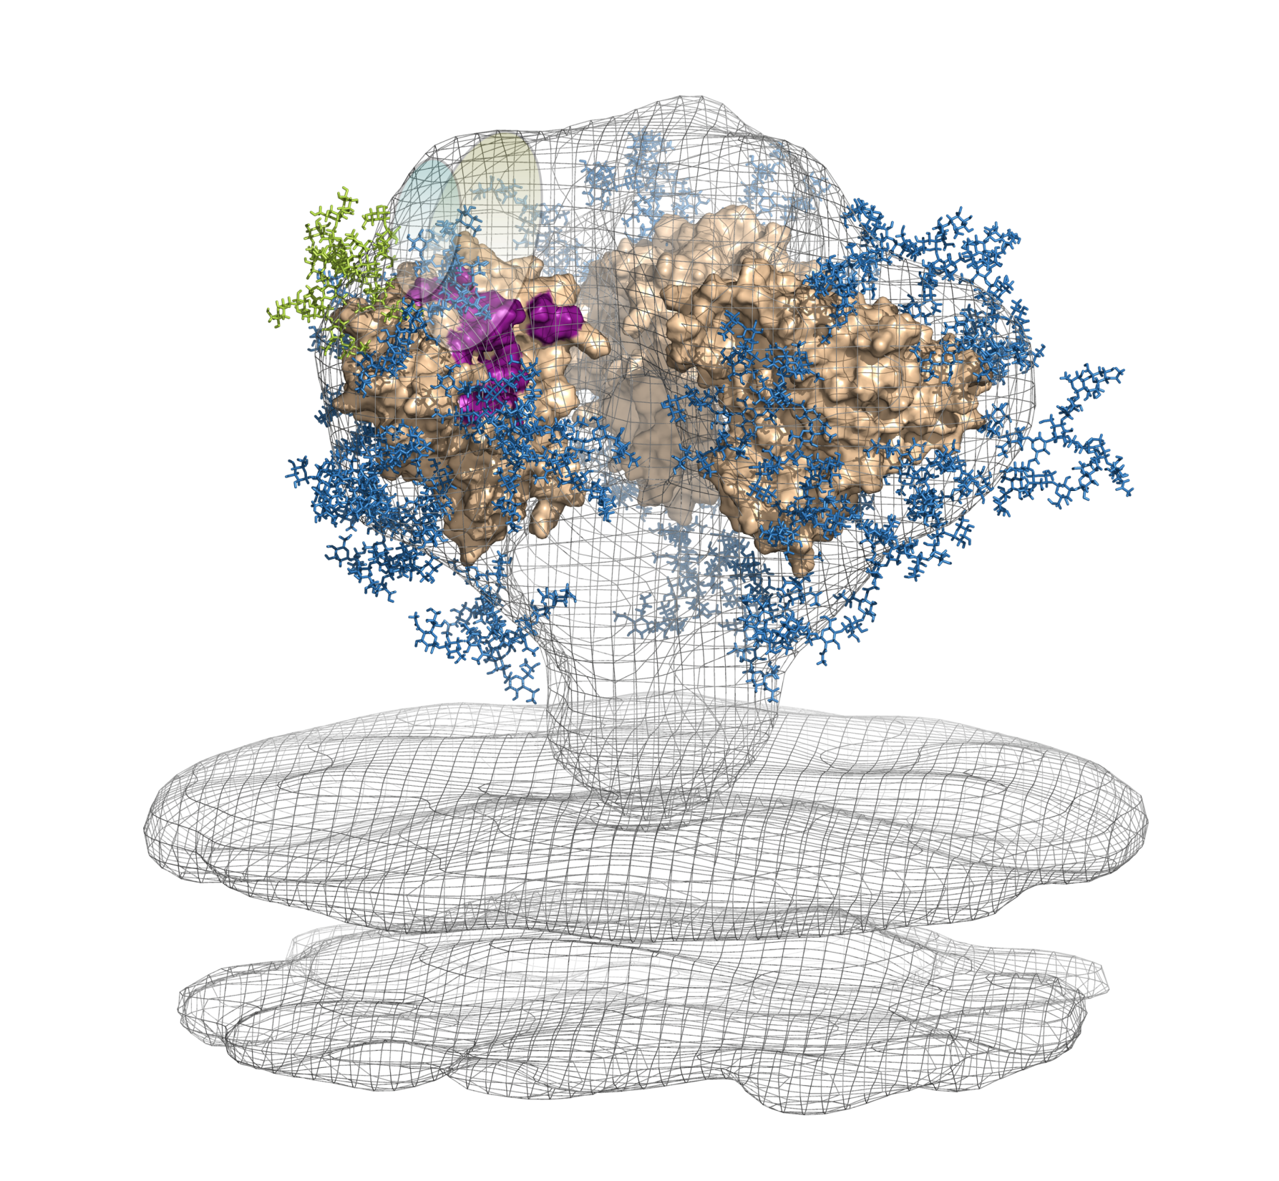
HIV vaccine targets defined by bnMAbs,
V1/V2 / glycans
(PG9)
Glycans
(2G12)
V3 / V4 / glycans
(cluster of targets:
PGT120s, PGT130s)
V3/CD4i
(3BC176)
gp120
MPER
(10E8)
CD4bs
(VRC01)
gp41
viral
membrane

Slide 40






Understanding how broadly neutralizing antibodies develop in HIV infection
Breadth
Years of Infection
UCA
(Unmutated common ancestor )

Slide 41
Eliciting Broadly Neutralizing Abs
BNAbs show an unusually high level of somatic hypermutation (Kwong et al, Nat Rev Immunol 2013; Mascola & Haynes, Immunol Rev 2013; West et al, Cell 2014).
The level of somatic mutation in the B cell lineage directly correlates with the neutralization activity of the Ab (Klein et al, Cell 2013; Sok et al, PLoS Pathog 2013; Bhiman et al, Nat Med 2015).
In the infected host, HIV-1 escapes immune pressure by continuously mutating, which results in a continuously evolving Ag presentation → this generates in turn a continuous evolution of the Ab response: bNAbs develop with time in response to the constant mutational modifications of the infecting virus.
Designing a vaccine able to induce bNAb remains the major challenge in HIV vaccine research: It has been impossible so far to induce bNAbs by immunization with any of the Env antigens or Env scaffolds tested. (The same applies to bNAbs against influenza or RSV)

Slide 42
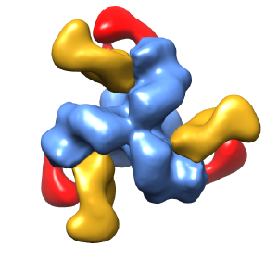
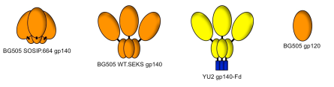

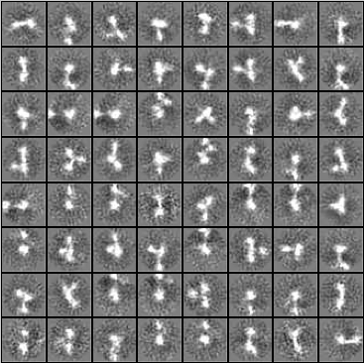
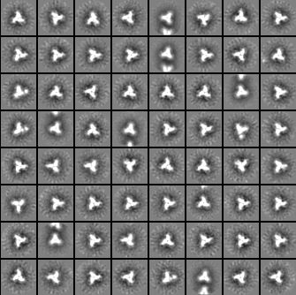


B cell immunogen design: SOSIP trimers
SOSIP.664 trimers
Induction of autologous Tier 2 NAbs
SOSIP.v5 trimers
Improved trimerization
Increased stability
Reduced V3 non-NAb epitope exposure
Reduced CD4i non-NAb epitope exposure
Improved bNAb exposure
Reduced V3 immunogenicity and Tier 1A NAb induction
P < 0.0001
Autologous neutralization titers
80% protection
50% protection
Uncleaved gp140
(Non-native trimers)
SOSIP.664 gp140
(Native-like trimers)
Improves existing trimers
Allows making new trimers
AMC008 SOSIP.v4.2
bNAb PGV04
bNAb 35O22
Sanders et al. 2013. PLoS Path. 9:e1003618
Sanders et al. 2015. Science 349:aac4223
De Taeye et al. 2015. Cell
Sanders: AMC

Slide 43
A possible answer
Hence the idea that sequential immunizations with a series of Env immunogens, with a gradually changing epitope structure , should elicit the evolution of the B cell germline through the evolving presentation of the Ag (Haynes et al, Nat Biotechnol 2012; Jardine et al, Science 2013; Steichen et al, Immunity 2016)
Mice were immunized sequentially, using a family of Env trimers (BG505-SOSIP) corresponding to the BNAb PGT121 B cell lineage with a progressively decreasing number of mutations in the gp120 gene (10MUT, 7MUT, 5 MUT, then wt) → induction of NAb that could neutralize several Tier-2 viruses (Escolano A, et al. Cell 2016)
This suggests this might be the right way to go?…

Slide 44
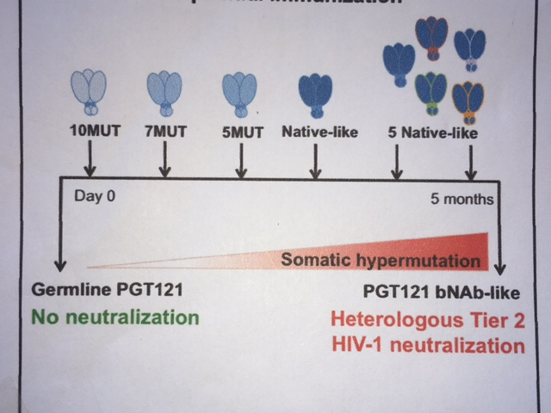
Eliciting PGT121 bNAb by sequential Immunization

Slide 45




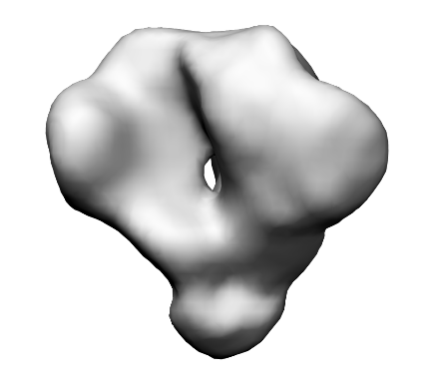
Sequential immunization strategies
Breadth
Years of Infection
Malherbe et al, 2011; Haynes et al., 2012; Moore et al, 2012; Liao et al, 2013

Slide 46
Immunisation passive
A défaut de pouvoir induire des Ac neutralisants à large spectre (BNAb) par la vaccination, on peut les utiliser avec succès en immunisation passive. On a testé notamment leur usage comme microbicide vaginal.
Problème: comment les produire en quantité suffisante?
Bonne nouvelle: contrairement à la grande majorité des vertébrés qui fabriquent des Ac avec des domaines HCDR3 de seulement 12-16 ac aminés, les Ac des bovins ont naturellement un domaine HCDR3 très long (26 ac aminés en général, jusqu’à 70 ac aminés)!
Indeed, BG505 SOSIP immunization resulted in rapid elicitation of broad and potent serum antibody responses in cows. Longitudinal serum analysis for one cow showed the development of neutralization breadth (20%, n = 117 crossclade isolates) in 42 days and 96% breadth (n = 117) at 381 days.
A monoclonal antibody isolated from this cow harboured an ultralong HCDR3 of 60 amino acids and neutralized 72% of crossclade HIV isolates (n = 117) with a potent median IC50 of 0.028 μg ml−1.
(D Sok et al, Nature 2017, 548, 108-11).

Slide 47
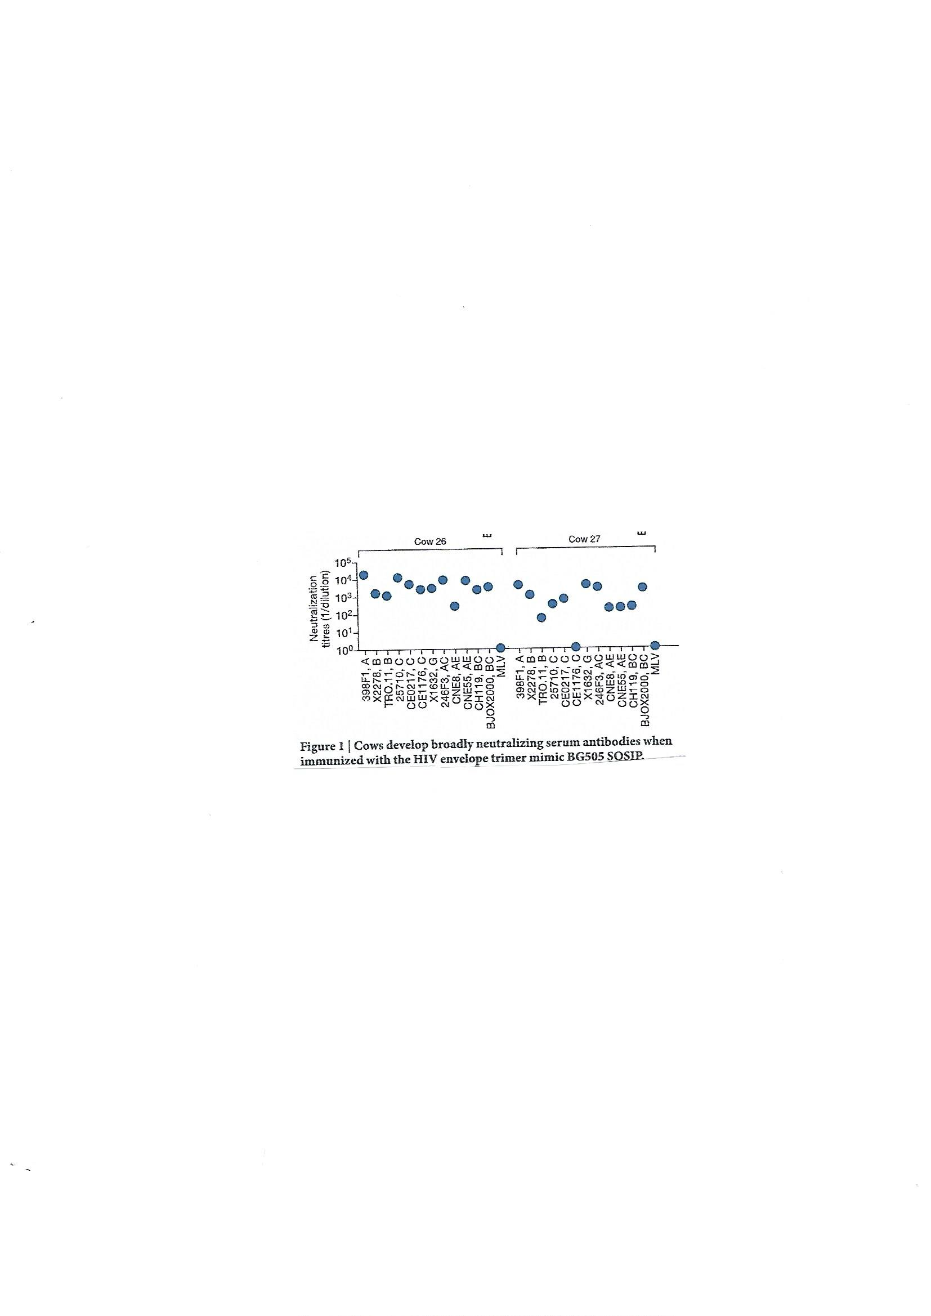

Slide 48
Immunisation passive (2)
Immunisation passive du macaque avec un seul BNAb: → protection contre l’infection par un SHIV R5… mais rapide apparition de souches virales résistantes (mutants d’échappement).
D’où l’idée de combiner plusieurs déterminants de BNAbs sur une seule molécule d’IgG (Xu L, et al, Science 2017, 358, 85-90)
  → Ac bi-spécifique (VRC01 sur un bras, PGT128 sur l’autre)
  → Ac tri-spécifique (VRC01 sur un bras, PGDM1400 +10E8 sur le 2ème) → epitopes reconnus: CD4bs, glycanes V1/V2, et MPER (gp41)
  → Essai de protection du macaque contre une épreuve SHIV BaLP4 (voie I/R):
  Anticorps Protection
  VRC01 seul 2 animaux sur 8
  PGDM 1400 seul 3 animaux sur 8
  Ac trispécifique 8 animaux sur 8
  (Xu et al, Science 2017; 358: 85-90)

Slide 49
Une alternative: « Genetic immunization »
A promising alternative to active immunization is the so-called « vectored immunization » approach (also called ‘vector immunoprophylaxis’ = ‘VIP’),
which relies on the IM injection of a recombinant AAV vector that can express the genes encoding the H and L chains of a bNAb
→ Persistence de l’AAV recombinant dans l’organisme
→ life-long expression of the H and L genes → broadly neutralizing MAb.
→ protection against HIV or SHIV challenges in humanized mice and/or monkey models (Johnson, Nat Med 2009; Balazs et al, Nature 2012).
→ Phase I/II clinical studies using AAV-vectored VRC01, PG9, and/or VRC07 Mabs have been started

Slide 50
Another role of nonneutralizing antibodies in protection
Multiple mechanisms for HIV to pass through mucosal barriers have been proposed that include transcytosis of HIV-1 across simple columnar epithelial layers (endocervix, rectum, GI tract). This can readily be demonstrated in vitro (Tudor, Mucosal Immunol 2009; Tudor, Nat Immunol 2009) : the virions penetrate into the cell by endocytosis and are transported across the cell wrapped in a transcytosis vesicle that releases them on the baso-lateral side of the epithelium
  Mucosal IgAs specific for HIV-1 gp41 MPER have been shown to block HIV-1 transcytosis across epithelial barriers in vitro (Alfsen, J Immunol 2001; Nguyen, J AIDS 2006; Shen, J Immunol 2010) = Transcytosis inhibition
  Such transcytosis-blocking IgAs can be found in the cervicovaginal secretions of highly exposed, persistently seronegative (HEPS) women

Slide 51
GP41-virosome immunization
(Bomsel et al, Immunity 2010)
Female macaque monkeys were immunized with rgp41 and an MPER peptide (P1) grafted onto virosomes: either 4 times by the IM route or twice IM then twice intranasally (IN).
The animals were then challenged 13 successive times by the vaginal route with a low dose (30 TCID50) of SHIV SF162P3 (once- or twice-a-week)
None of the IM/IN immunized females, and only 3/6 IM immunized females, became infected vs 6/6 placebos
All the protected animals had developed transcytosis-blocking IgAs in their vaginal secretions. None showed evidence of NAbs in their serum

Slide 52
So, what do we have in the pipe at this time?
A variety of prime-boost regimens using DNA as a prime and live vectored vaccines (Ad26, Ad35, Ad48; and/or MVA) as a boost. These vaccine approaches are at various stages of clinical trials.
So is a study of DNA vs MVA prime+ gp140 boosts
  Mixed modality prime-boost regimens : Ad26 followed by MVA then gp140 as compared to Ad26 followed by gp140, using mosaic antigens→ expected to go into Phase III efficacy trial in 2018.
  A Phase III clinical trial (HVTN702 ) based on the RV144 model, which is on-going in South Africa with a clade C canarypox (ALVAC ) vaccine as a prime and a clade C gp140 as a boost, using MF59 as an adjuvant . The trial involves 5 clade C injections over 12 months (vs 4 clade AE injections over 6 months in the RV144 trial)

Slide 53
A new vector: CMV
Simian cytomegalovirus (Rh CMV) was tested as a vector (Louis Picker’s group)→ Simian CMV recombinant vaccine that expressed SIV Gag, Rev, Tat, Nef, and Env → SIV challenge: Viral loads in 50% of the challenged animals remained mostly undetectable (except temporary blips ) for one year follow-up.
After one year, no more virus blips were observed and no viral RNA nor DNA could be recovered from the protected animals = A cure!!
Protection correlated with mucosal T cell responses, especially CD4+ and CD8+ TEM cells.
Surprizingly, the cytotoxic CD8⁺ TEM cells elicited by the recombinant RhCMV /SIV vaccine were reactive to epitopes presented by nonclassical major histocompatibility complex E (MHC-E) molecules!..., not MHC-A nor –B!

Slide 54
Walker B. Nat Med 2011

Slide 55
Nouveaux vaccins potentiels
Plusieurs nouveaux vaccins recombinants sont aussi en développement, notamment:
  1. Un virus de la rougeole recombinant, MV-p55GagSIV,gp160EnvHIV→ protection de 50% des macaques Cynomolgus contre une épreuve SHIV162P3. (F Tangy, Institut Pasteur)
  2. Un lentivirus recombinant, LV-p24GagSIV→ protection de macaques Rhesus contre une épreuve SIV voie rectale (P. Charneau, Institut Pasteur)
  3. Un virus de la fièvre jaune (souche 17D) recombinant YF17D-CH505gp120 HIV (J-S Yu Duke University Med Ctr ) ( J-S Yu et al, J Virol Methods 2017, 249: 85-93)
D’autres approches sont aussi en cours de développement:
  Des IgA recombinantes type IgA-SOSIP, ou, mieux encore, des complexes trivalents
  IgA-SOSIP-p24 → induction d’Ac neutralisants (S. Paul, GIMAP, St Etienne)

Slide 56
Conclusion-1: The T-cell response
Control of viremia in SIV/SHIV/HIV infection correlates with and is dependent on CD8+ CTLs in macaques and chimpanzees (Belyakov Blood 2006 and J Immunol 2007), especially with high-avidity, polyfunctional, degranulating mucosal tissue-based CD8+ CTLs
The polyfunctional , continuous CD8+ TEM cell response elicited in macaque monkeys by live recombinant CMV- SIV vaccine controlled SIV infection and made 50% of the animals virus-free after one year infection.
Question: could one develop a similar vector suitable for human populations? (A HCMV-HIV vaccine using a CMV Toledo/Towne chimeric vector was planned to enter Phase I clinical trials in 2017?)

Slide 57
Conclusion-2: Neutralizing antibodies
Passively transferred, broadly neutralizing antibodies efficiently protected NHPs against experimental SHIV challenge (Hessel , Nat Med 2009). Passive immunization trials in human volunteers are on-going.
However, we still do not know how to induce bNAbs by active immunization! The search for a possible immunogen or a combination of immunogens is actively going on. The sequential use of SOSIP trimers with a evolutionnary sequence seems to be able to elicit Abs that neutralize Tier-2 virus strains in small animals: a possible approach?
As an alternative, could « Vectored immunoprophylaxis » using recombinant AAV that express bNAbs genes be a key to success? Future, upcoming clinical trials will tell.

Slide 58
Conclusion-3: Non-neutralizing Abs
Non-neutralizing mucosal Ab (essentially gp41-specific IgAs) that inhibit HIV/SIV transcytosis across an intact epithelial cell layer correlated with reduced chronic viremia after rectal SIV challenge or full protection against vaginal SHIV challenge in NHP models.
These Ab thus play an important role in mucosal protection.
Nonneutralizing Env-specific IgGs can also play a major role in protection through ADCC and ADCVI, as seen in a variety of SIV and SHIV vaccine protection experiments in rhesus macaques.
IgGs targeting the V1-V2 domain of gp120 were the only correlate of protection in the RV144 trial in human volunteers. Rabbits immunized with a V1V2-scaffold immunogen developed V1V2- focussed Ab with marked ADCC activity (Zolla-Pasner et al, J Virol 2016)

Slide 59
Final conclusion
An ideal HIV vaccine should elicit:
  broadly neutralizing IgGs,
  mucosal IgAs with transcytosis inhibiting capacities,
  Ab-dependent ADCC /ADCVI activities,
  V1-V2-targeting IgGs
  As well as potent, multifunctional CD4+ and CD8+ T cell responses in mucosal tissues.
At this time, we simply do not know how to achieve all of that, nor do we know whether it will ever be possible!…

Slide 60
En guise de fin
« Teaching the immune system how to outwit a virus that itself survives by outwitting the immune system is a huge scientific hurdle. » (J Cohen, Science 21 septembre 2012)
« What is success? It ‘s going from failure to failure with undiminished enthusiasm » (Winston Churchill)
« Oser toujours, douter parfois, ne renoncer jamais »
(Always dare, doubt at times, but never quit!)
(Maud Fontenoy, French solitary navigator)

